Slide 1
All COB Meeting
Fall 2019
David Meinert, Dean
August 16, 2019

Slide 2
Welcome New Hires
Information Technology and Cybersecurity
  Raju Mainali, Ph.D. University of Nevada, Reno
Marketing
  İsmet Anıtsal, Ph.D. The University of Tennessee, Knoxville
  Jamie Grigsby, Ph.D. Kent State University
  Peggy Kahre, Administrative Assistant II (effective August 26th)
Technology and Construction Management
  James Peterson, Ph.D. Missouri University of Science & Technology
Business Advisement Center
  Anna Clymer, Academic Advisor/Retention Specialist
Graduate Programs
  Lane Nichols-Elliott, Academic Advisor

Slide 3
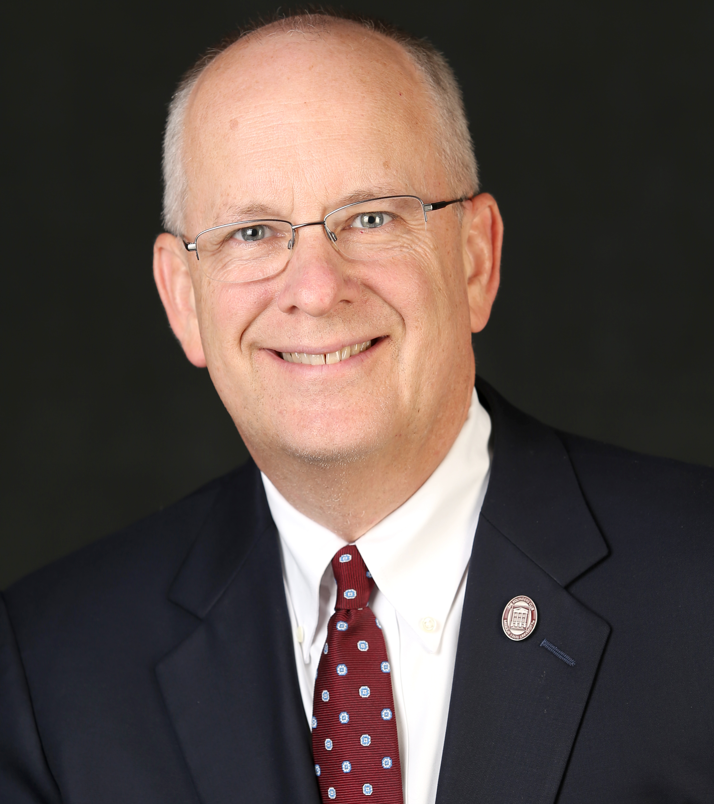
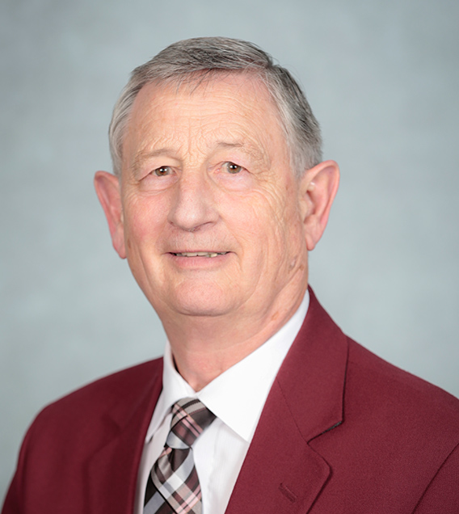
Special Guests
President Clif Smart
Provost Frank Einhellig

Slide 4
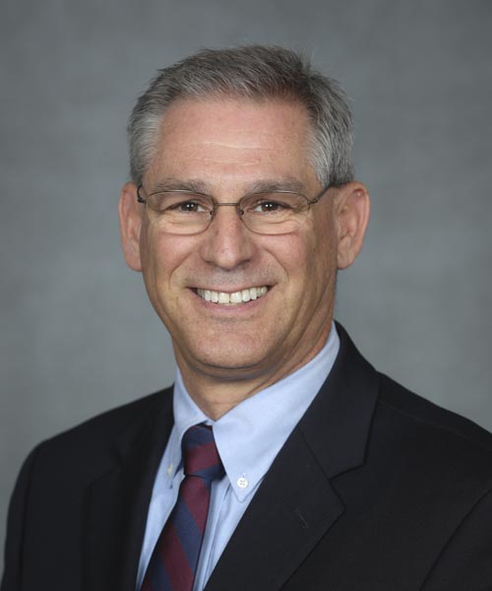
University Safety
David hall, Director

Slide 5
Agenda
Strategic Plan - Action Items
Building Our Brand
& Recruiting Students
  Action Items
  MSU Experts List
  Promoting Success Stories
  Digital Display Content
Career Fairs
Search Updates
AACSB Updates
KPIs
International Business Programs/
Study Away
Building Updates
Departmental Shout-Outs
Daisy Portenier Loucks Professors
Fall Commencement
Q/A

Slide 6
Strategic Plan
Action Items
Will be distributed via INSIDE COB
Will involve deans, department heads, faculty, and staff

Slide 7
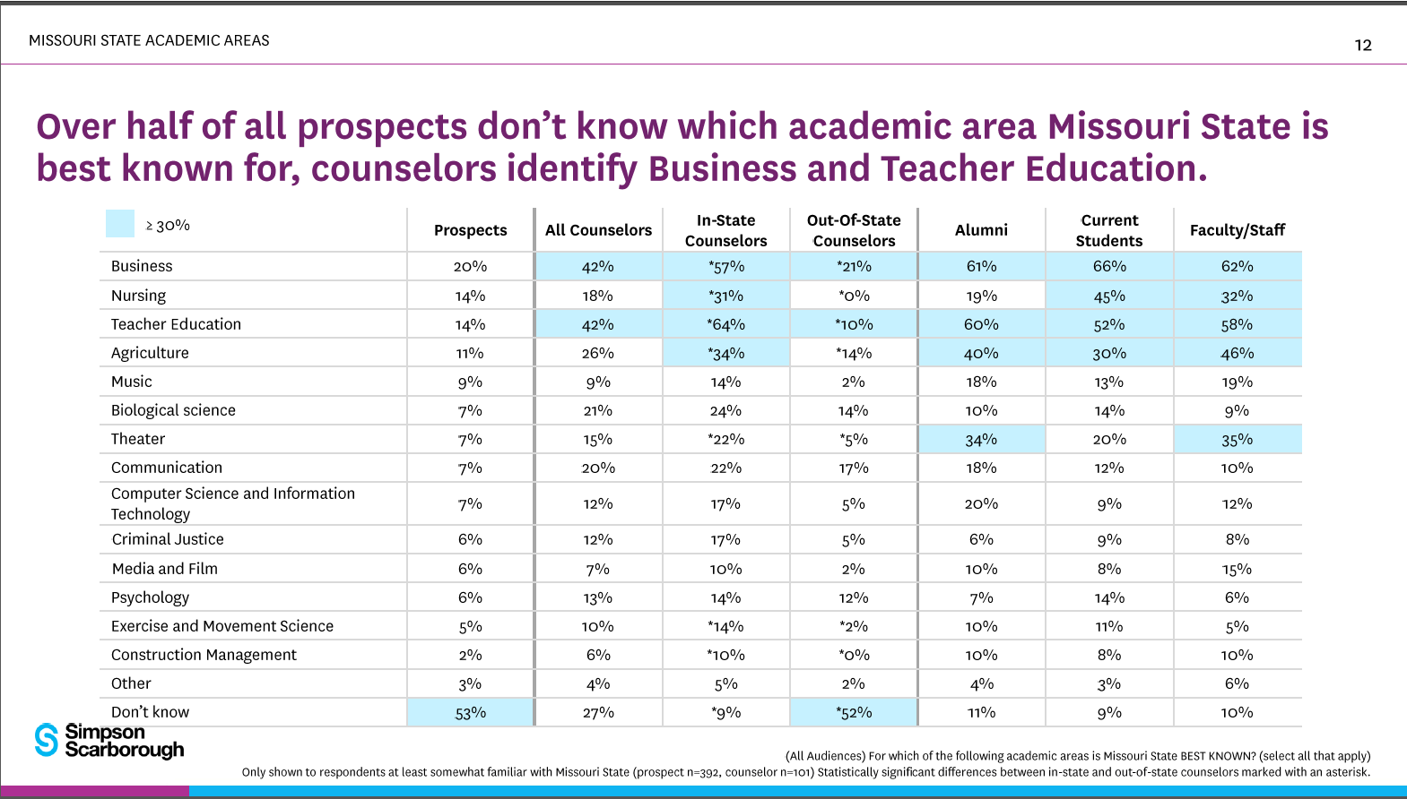
Recent MSU Brand Research

Slide 8
2019/2020 Action Items
Focused on Recruitment
Business Careers Guide – all MO HS Counselors
YouVisit Virtual Tour
Digital Marketing Campaign
Attend more College Fairs
Increase H.S. Visits
Host more H.S. groups
Increased visibility during On-campus Recruiting Events

Slide 9
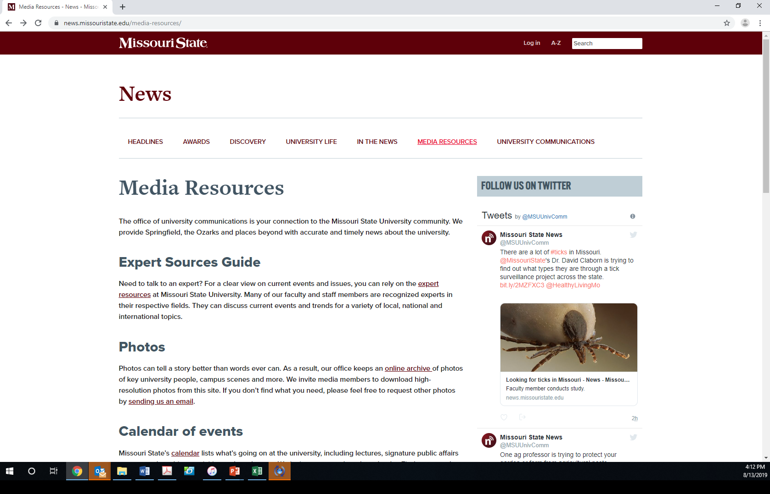
MSU Experts List

Slide 10
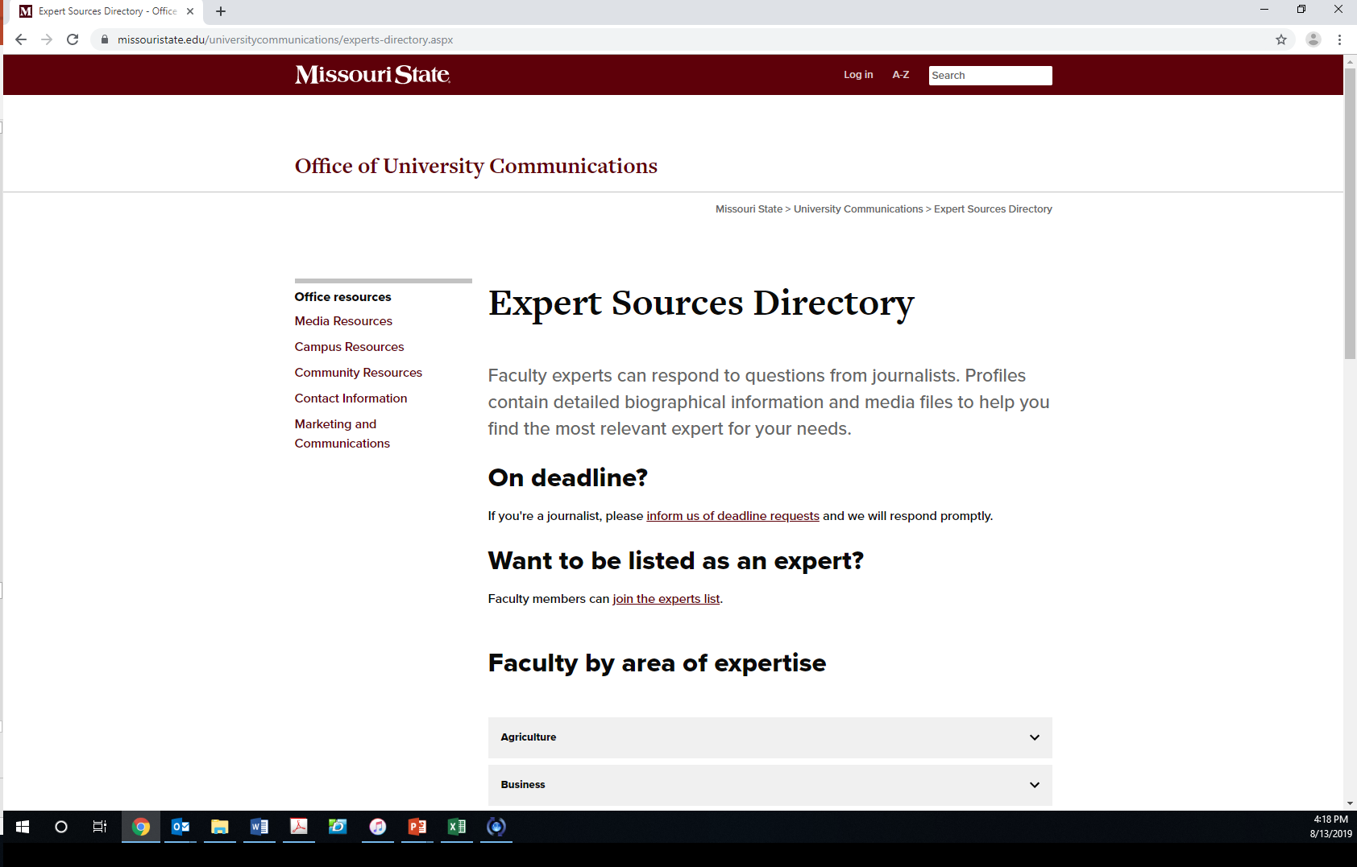
Join the MSU Experts List

Slide 11
Promoting COB Success Stories
COB > Faculty Resources and Policies -> Other Resources -> COB Faculty, Staff, and Student Recognition Form

Slide 12
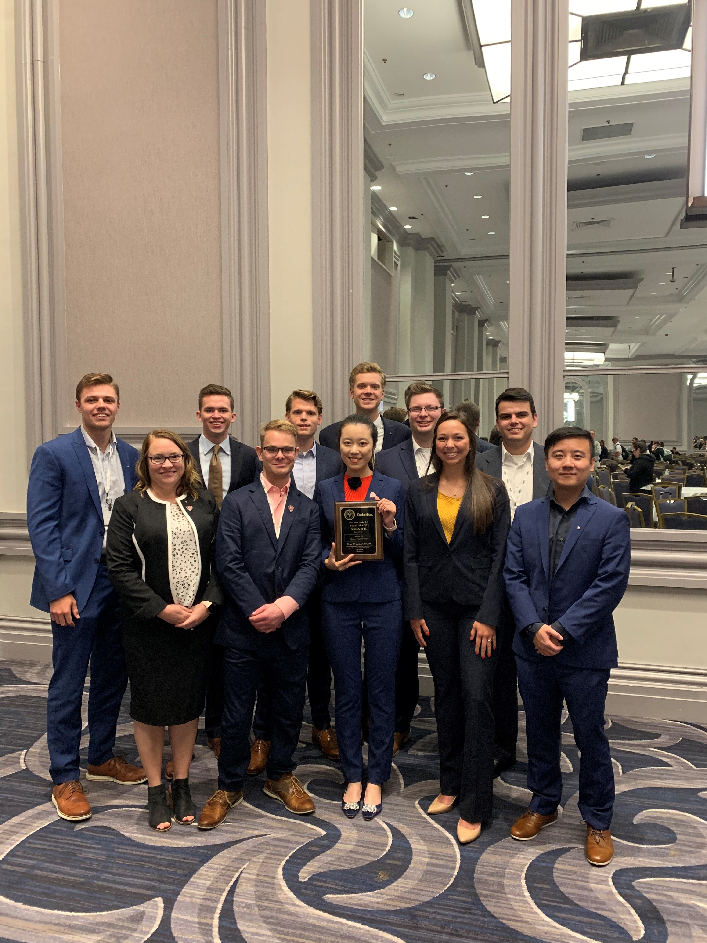
Our most recent success story…
Beta Alpha Psi - 1st 2019 Nationals

Slide 13
Digital Displays
Departmental Displays
  Submit content to your departmental Administrative Assistant
College Displays (Glass/Kemper/PCOB)
Submit content to Mary Grace Phillips, MaryGPhillips@MissouriState.edu.

Slide 14

COB Career Fairs
Fall 2019
Accounting Career Fair
Wednesday, September 4, 2019
12:00 - 3:00 pm
University Plaza Hotel
College of Business Career Fair
Tuesday, September 10, 2019
10:00 am - 2:00 pm
Springfield Expo Center
New Career Fair Plus App
FREE!
There will be no workshop waivers granted for fall 2019 fairs. All students must attend a Prepare for the Fair workshop.

Slide 15
COB Career Fairs
70 firms who have attended in the recent past have not yet registered.
Employer Registrations
  Accounting Career Fair – 32 Business Career Fair -- 114
Prepare for the Fair Workshops
  Required attendance for all participants
  15 Workshops - 8/20 - 9/7
  Students have already been emailed twice, numerous social media posts
  Digital displays will promote both the fairs & workshops
How can you help?
  In-class
    Encourage students seeking internships and FT positions to attend a fair
    Remind students of the mandatory workshop requirement and new Career Fair+ app
  Blackboard
    In upper-division & select lower-division courses post an Announcement (provided by Melissa)
  Faculty attendance at the fairs -- interact with students & recruiters

Slide 16
Search Updates
Associate Dean – first date of consideration 10/7/19
Director, SOA – first date of consideration 10/7/19
Department Head, MGT – first date of consideration 10/7/19
Assistant Professor MGT – first date of consideration 8/19/19
Assistant Professor FGB – first date of consideration 8/15/19

Slide 17
AACSB
Continuous Improvement Review (CIR) Timeline
2017-2018 Internal Annual Report
2018-2019 Internal Annual Report
2019-2020 Internal Annual Report
2020-2021 Internal Annual Report
2021-2022 Self-Study Year
2022-2023 Preparation & Submission of CIR Report
CIR Peer Review Team Visit

Slide 18
AACSB Peer
Peer review team Recommendations
Distinguish between initial qualification for SP and IP and define “substantial”
Formalized approach to reviewing COB core
(Undergraduate Core Curriculum Committee)
Refine expectations for research impact and quality
Post student achievement data on website
☑
☑
☑
☑

Slide 19
AACSB
Areas of Emphasis
Peer Review Journals
Faculty Qualifications
AOL
Strategic Plan
Emphasis on Public Affairs
New standards coming

Slide 20
AACSB
Tables 15-1 and 15-2

Slide 21
Key Performance Indicators
2018-2019
Quality of Students—Incoming COB freshmen avg ACT 23.71; National avg 21
Number of students—5,559
Student Diversity—641 (underrepresented students)
Retention—COB 76.9%; MSU 77.66%
Career Fair—142 firms
Student participation at career fair—693
Job Placement—85% (2017-2018 data from Career Center on undergrad students)
Students participating in Study Away—189 total
Diverse faculty hires—50%
Research quantity and quality—288 PRJs in five year window; 60% basic scholarship

Slide 22
Study Away Stats 2018-2019
28% Increase
Year-over-year
$100K in SA Scholarships

Slide 23

Study Away
Important Dates & Deadlines
Fall ’19
Australia/Fiji (9 students, 3 guests)
Courtney Pham
Scotland (10 students 1 guest)
Jason DeBode
The deadline for submitting a 2020 STFL proposal is Sept. 27.
Study Away Fair: Thursday, Sept. 12, 11-2 in PSU
Students are already stopping in IBP to ask “what’s available?”

Slide 24
International Business Programs
Opportunities for faculty
Study Away Mentor Program
  Faculty Resources and Policies -> Study Away Mentor Program
Magellan Faculty Exchange
  Details available at http://ibp.missouristate.edu and http://www.magellanexchange.org

Slide 25
SU19 Building Projects
Glass 434 & 467 Full Renovation
Kemper 126 Full Renovation (computer lab)
Glass 331 Major Renovation
Glass 227, 230, and 261 Partial Renovation
Glass 102 New Seating Installed
Glass 108 Seat Cushions
Glass (226, 227, 230, 261, 262, 340, 342, 428, & 435)
  Network cables relocated
  Eliminated tripping hazard
  New ceiling speakers
  Rebuilt computer carts with Crestron touchpads

Slide 26
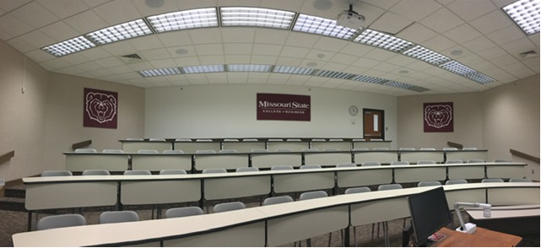
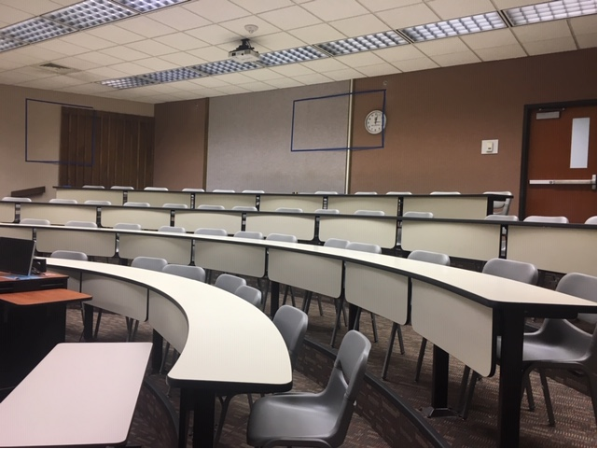
GLA227 Before/After
Minor Renovations Make a big difference

Slide 27
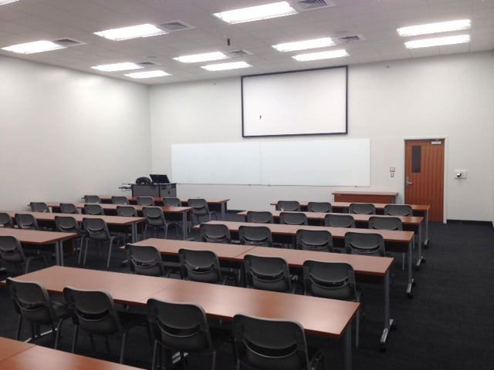
Glass 434 Remodel

Slide 28
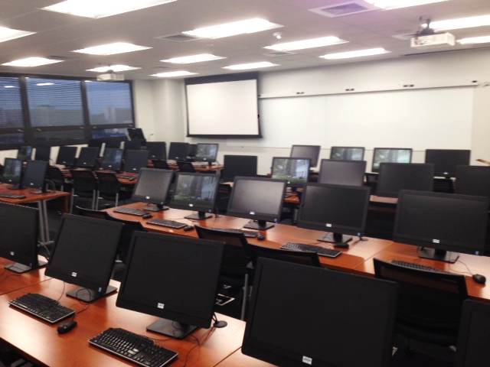
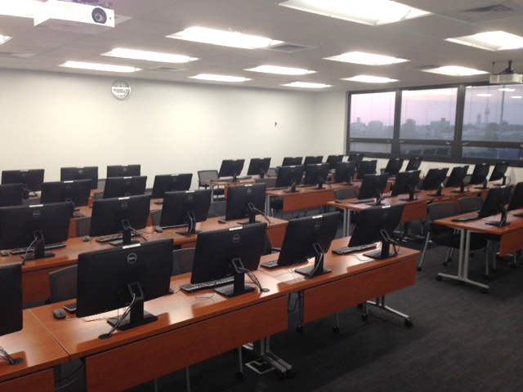
Glass 467 Renovation

Slide 29
No More Motorized Screens
Classrooms w/ Rear Projection Screens (GLA340-350 & GLA428-433)
  Glass screens covered w/ projection screen paint
  Select rooms will have motorized screens until Crestron carts are upgraded
All other classrooms have wall-mounted screens

Slide 30
Reserving Specialty Space & Hallway Tables
Anyone interested in reserving specialty space or hallway tables should contact Stef Hall, 64408
Specialty spaces include:
  O’Reilly Auto Parts Grand Atrium
  American National Insurance Auditorium (354)
  Marlin Think Tank for Creative Thinking in Business (355)
  Executive Board Room (485)
  Jim and Pat Jones Reception and Meeting Room (486)

Slide 31
Shout-Outs
Departmental
Business Advisement Center, Sandy Culver
School of Accountancy, Dick Williams
Finance and General Business, Jeff Jones
Information Technology and Cybersecurity, Joshua Davis
Management, Jason DeBode
Marketing, İsmet Anıtsal
MBA, Elizabeth Rozell
Merchandising and Fashion Design, Elizabeth Rozell
Technology and Construction Management, Neal Callahan

Slide 32
Daisy Portenier Loucks Professors (2019/2020)
Christina Simmers (MKT)
Carol Miller (FGB)
Ed Chang (FGB)

Slide 33
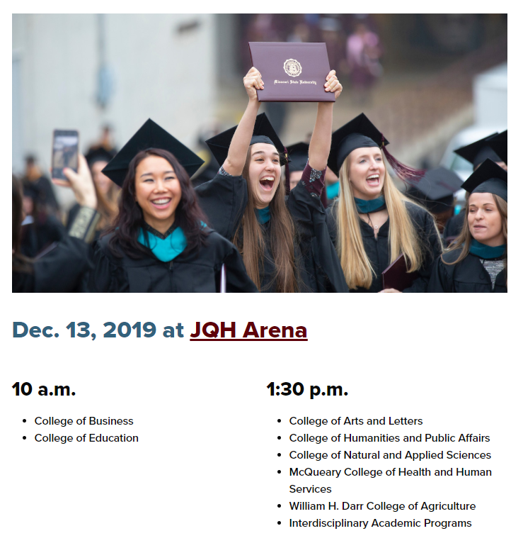
Fall Commencement
Save the date & Order Regalia (if needed)

Slide 34



TITLE
Have a
Great Year, and…
Content

