Slide 1
All COB Meeting
Spring 2019
David Meinert, Dean
May 10, 2019

Slide 2
Reminder #1 – an ALL GRAD COB will be held immediately following this meeting to vote on RULES OF THE MBA POLICY AND CURRICULUM COMMITTEE
Reminder #2 – an FEC meeting will be held immediately following the ALL GRAD COB meeting

Slide 3
Academic Announcements
Adobe Connect
  Adobe Connect (video conferencing) license ends May 31, 2019
  Users wishing to retain Adobe Connect sessions/materials must download them from the server before June 1, 2019
  If you need assistance downloading materials or transitioning to another video conferencing tool (e.g., Blackboard Collaborate, Zoom, or SKYPE), please contact MSOnline@MissouriState.edu

Slide 4
Academic Announcements
Study Sites Providing MSU Exams
  The Academic Integrity Council has reported a significant increase in the number of MSU exams that can be found online
  Recommendations
    Treat post-exam reviews the same as exams – no cell phones (no pics)
    Consider retaining, rather than distributing graded exams
    (refrain from shredding until grade appeal period expires)
    Dispose of old exams departmental shred bins
    Update/change exams each semester
    Explicitly label exams to expedite removal by reputable web site operators
      “All rights reserved © 2019 John Doe”
      “This is an Exam and is NOT intended to be used as a study guide”

Slide 5
Academic Announcements
Qualtrics
Danny E. Winkler
Instructional Tech Support
COB Computing
  Qualtrics is a subscription software for collecting and analyzing data for market research, customer satisfaction and loyalty, product and concept testing, employee evaluations and website feedback. is a subscription software for collecting and analyzing data for market research, customer satisfaction and loyalty, product and concept testing, employee evaluations and website feedback.
  To obtain access to the software please contact COBComputing@missouristate.edu

Slide 6
Agenda
AACSB Timeline | Study Away
Fall 2019 Career Fairs FY20 Budget Outlook
Search Updates
New Hires | All-Faculty Recognition
Building Updates | COB Retirements
Shout-Outs | COB Awards

Slide 7
AACSB Accreditation Update
Business and Accounting Accreditation
unconditionally extended for five years
Celebration is short-lived…
2017-2018 Internal Annual Report
2018-2019 Internal Annual Report
2019-2020 Internal Annual Report
2020-2021 Internal Annual Report
2021-2022 Self-Study Year
2022-2023 Preparation & Submission of CIR Report
CIR Peer Review Team Visit
CIR - Continuous Improvement Review

Slide 8

Fall 2019 COB Career Fairs
Accounting Career Fair
Wednesday, September 4, 2019
12:00 - 3:00 pm
University Plaza Hotel
College of Business Career Fair
Tuesday, September 10, 2019
10:00 am - 2:00 pm
Springfield Expo Center
New Career Fair Plus App
FREE!
There will be no workshop waivers granted for fall 2019 fairs. All students must attend a Prepare for the Fair workshop.

Slide 9
AOL for 2018/2019
Dr. Elizabeth Rozell
Revision Update
Data collection will begin again in Fall 2018
Contact: Kate Haring, 6-5072

Slide 10
Budget Outlook FY20
Tuition Increase (5%)
  1.1% 2018/2019 increase approved, but waived
  1.9% Allowable CPI increase
  2.07% HESFA adjustment for lower appropriation in FY18
State Equity Adjustment - $10M
Enrollment Projections
  660 fewer students for FA19
  $4.5M reduction in tuition revenue

Slide 11
Net Available/(Shortfall) Funds for Budget from FY19 Revised Budget
Net Credit Hour Tuition/Fee Revenue Shortfall 2019 | $ (254,399.00)
Tuition/Fee Increase | $ 2,207,489.00
Tuition/Fee Increase waived FY19 | $ 826,425.00
Subtotal Tuition/Fee Impact FY20 | $ 2,779,515.00
Forecasted Credit Hour Decline FY20 | $ (4,559,810.00)
Brick City Financing Savings | $ 134,000.00
Interest Income | $ 1,444,000.00
FY20 Appropriation Increase (MSU SGF Share of Equity Adj.) | $ 9,048,492.00
Total Estimated Net Revenue Change | $ 8,846,197.00

Slide 12
Total Estimated Net Revenue Change |  | $ 8,846,197.00
COLA Increase 1% + $600 on 1/1/2019 | $ 1,260,450.00
MOSERS | $ 1,269,020.00
FLSA Exampt Salary Threshold on 1/1/2020 | $ 22,952.00
Salary Range Adjustment on 1/1/2020 or7/1/2019 | $ 88,674.00
COLA Increase 1.9% FY20 on 1/1/2020 or 7/1/2019 | $ 2,594,390.00
Student Employee Minimum Wage Increase (Centrally funded) | $ 333,336.00
GA Stipend COLA Increase 1.9% 7/1/2019 | $ 79,283.00
Cost Reductions Academic Areas | $ (1,200,000.00)
Cost Reducations: Non Academic Areas | $ (1,200,000.00)
Scholarships/Recruitment | $ 800,000.00
Other Expense Increases | $ 1,687,672.00
Total Estimated Expense Changes |  | $ 5,735,777.00
Net Available/(Shortfall) Funds Before Non-Recurring Items |  | $ 3,110,420.00
New One Time Funding Item - Greenwood Multi-Purpose Room Addition |  | $ 3,200,000.00
Net Available/(Shortfall) Funds After Non-Recurring Items |  | $ (89,580.00)
Salary & Benefits

Slide 13
OTHER EXPENSE INCREASE
Internet Growth Cost | $ 176,953.00
Faculty Promotions inc. Fringe | $ 325,444.00
PSIP inc. Fringe | $ 34,475.00
Nursing (2 positions) | $ 192,467.00
Property Insruance | $ 145,000.00
Employee Fee Waivers | $ 228,734.00
GA Fee Waivers | $ 336,214.00
ERP Contract Increase | $ 80,135.00
Police Contract | $ 16,000.00
ADA Software | $ 55,000.00
Marketing | $ 52,250.00
Title IX | $ 45,000.00
Other Expense Increase | $ 1,687,672.00

Slide 14
Fiscal Health of the College
Salary Savings (unallocated salary)
  Approximately one tenure track position w/ fringe
The Opportunity Cost of Increasing Open Lines to Market Rates
  At least $279,140 in salary savings expended since 2014/2015
One Time Monies (primarily from open faculty lines) will not be replenishing at past rates
UG Fee Monies
  Increased year-on-year (addition of 200 level courses & 50/50 split)
GR Fee Monies
“E” Program Surplus

Slide 15
Searches Updates
Director, School of Accountancy (SOA)
  Failed, new search starting SU19
Head, Department of Marketing (MKT)
  Dr. Ismet Anitsal will join us in early July
Head, Department of Finance and General Business (FGB)
  Dr. Jeff Jones appointed March 1, 2019

Slide 16
New Hires for 2019/2020
Marketing
  Jaimie Grigsby, Ph.D., Kent State University
MIT
  QBA Instructor search in progress
TCM
  James Peterson, Ph.D., Missouri University of Science & Technology

Slide 17
Fall 2019 Searches
SOA Director
MGT Department Head
Associate Dean

Slide 18
Building Projects
Completed
Classroom ceilings/walls cleaned
Glass 345 spruced up – it’s a “flex” room
Glass 227 and 230 – spruced up
Glass 101 and 108 chairs cleaned
Glass 262 painted and coat closet removed

Slide 19
Building Projects
Summer 2019
Kemper: New lab in 126 (trading 105 to CNAS). Gain garage and exterior access.
Glass 434 – New HVAC ductwork and lower ceiling. Complete remodel. Capacity to 54.
Glass 467 – Complete remodel. Capacity to 48 computers.
Glass 101/102/108 new glass whiteboards
Glass 102 – new fixed seating – capacity increasing to 140
Glass 108 – new cushions
Glass 101 – replacing worst cushions with some from 108
Painting 261
LED Lighting in 345 – test case

Slide 20
Building Projects
No more tripping
Floor cables going under floors!!!
Re-cabling projectors, etc.
New ceiling speakers

Slide 21
Building Projects
No more motorized screens
Classrooms without rear projection screens – new wall-mounted screens
Classrooms with rear projection screens – painting them white (reduce viewing angle for front lower rows)

Slide 22
Building Projects
Beyond Summer 2019
PRELIMINARY Multi-year classroom remodel project:
Plan is to not vacate – use flex room

Slide 23
Custodial Update
Supervisor moving into an office on Second Floor
Team approach – two custodians share Third and Fourth Floors
Checklists and accountability

Slide 24
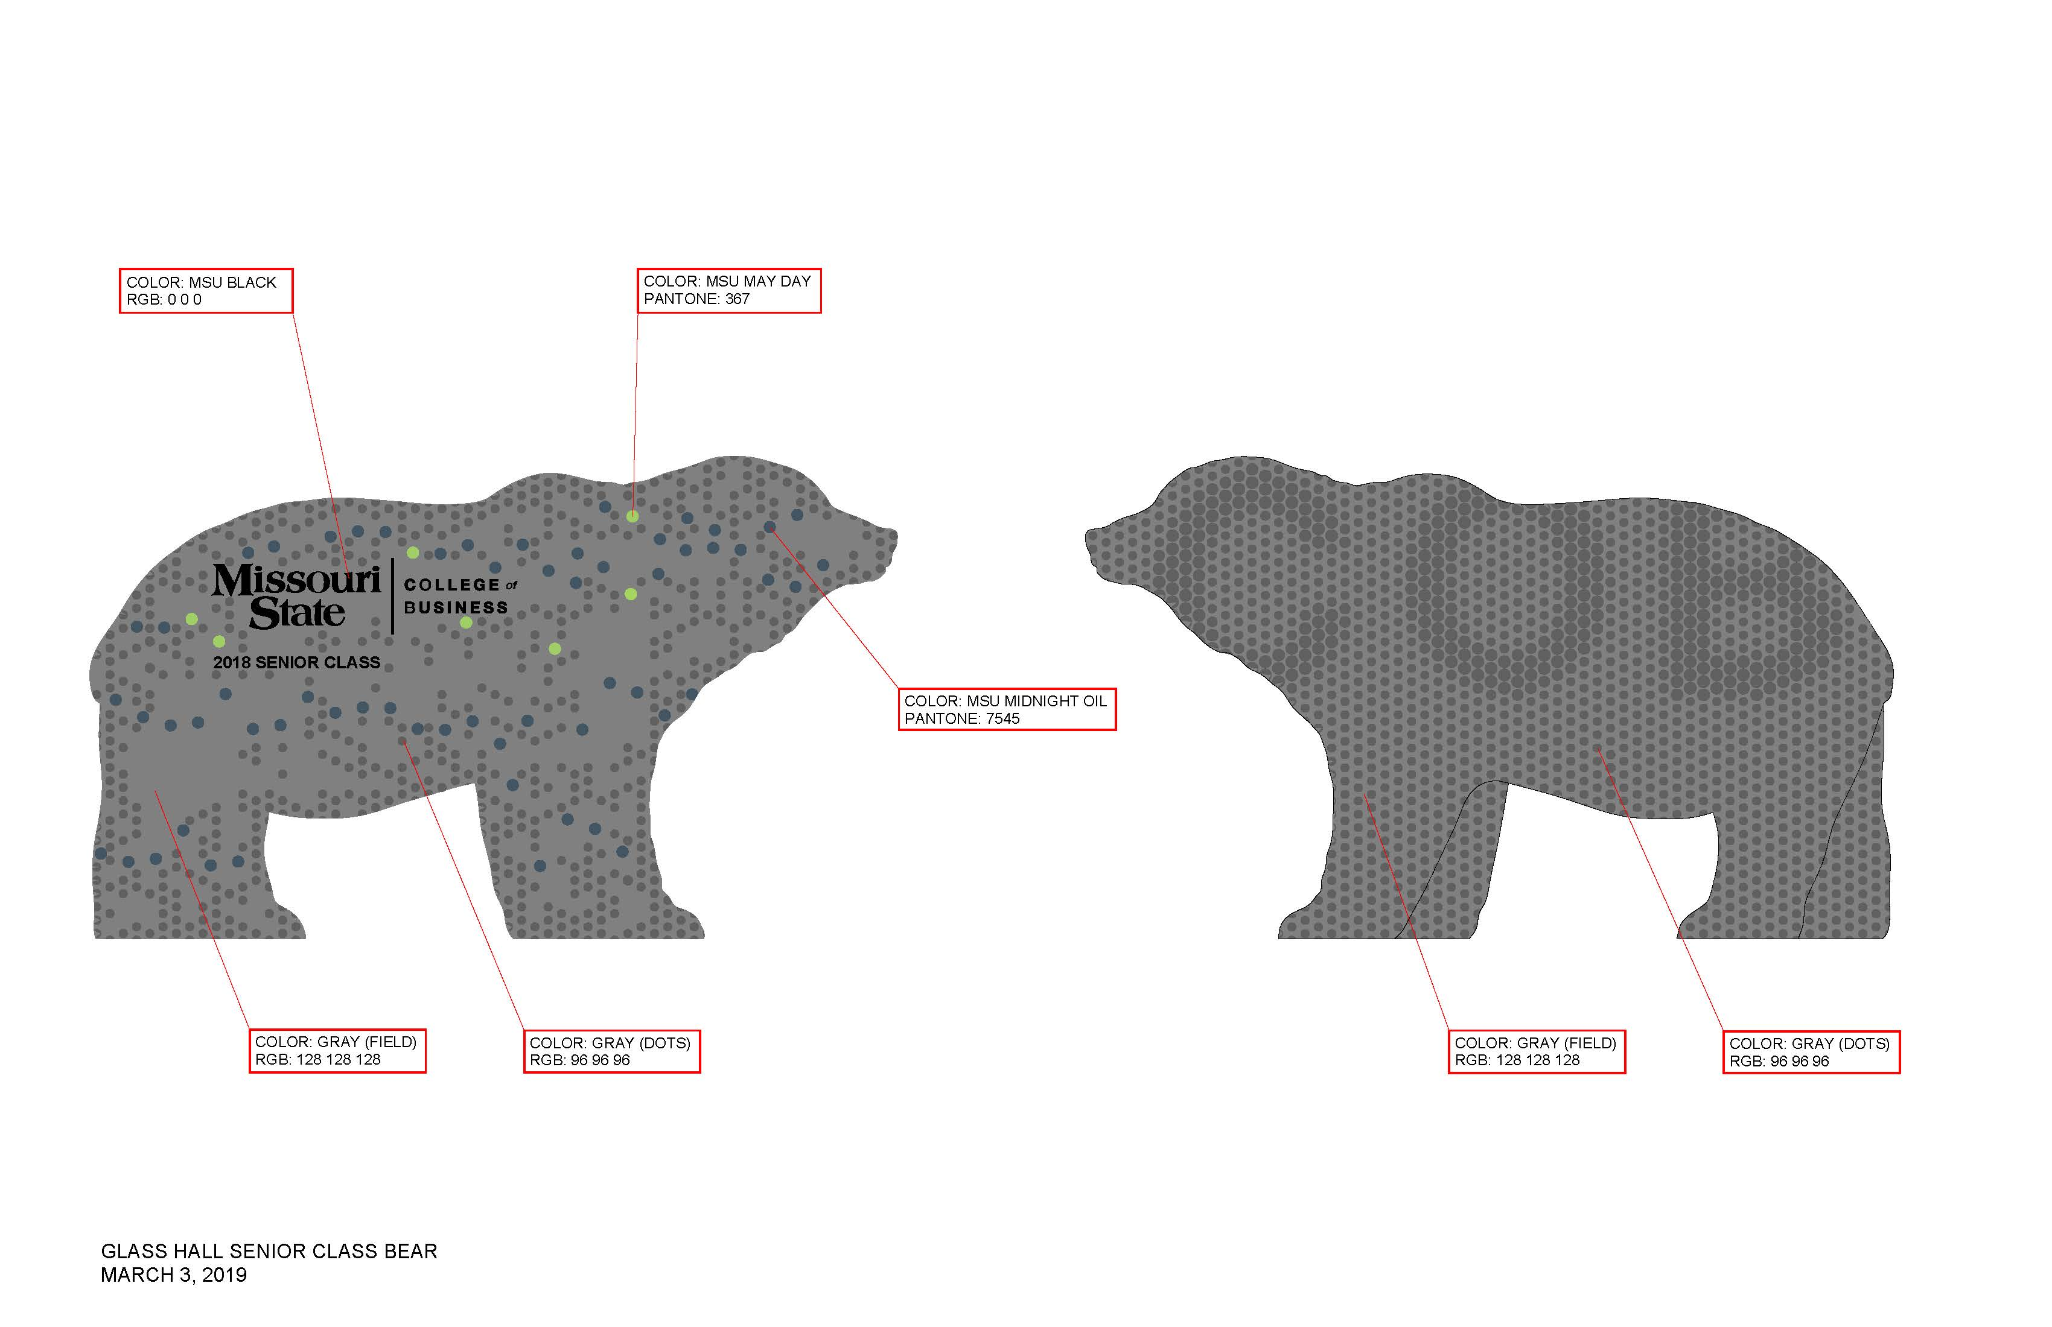
Senior Class Gift

Slide 25
Faculty & Staff
Shout-Outs

Slide 26
Shout-Outs
Departmental
Business Advisement Center, Sandy Culver
School of Accountancy, Dick Williams
Finance and General Business, Jeff Jones
Management & Information Technology, Joshua Davis
Marketing, Ron Coulter
MBA, Elizabeth Rozell
Merchandising and Fashion Design, Elizabeth Rozell
Technology and Construction Management, Neal Callahan
EMBA, Kent Ragan

Slide 27
Study Away
Registered Study Away students
142 AY 17-18
189 AY 18-19
2018-19 STFL Programs
January
Hong Kong/Singapore (8 students)
Jenny Zhang & Kathleen Larkin
Spring Break
Chile (17 students,1 guest)
Chuck Hermans
Ireland (14 students)
Michelle Hulett
Scotland (6 students)
Cathy Van Landuyt
UK/France (14 students, 1 guest)
Phil Rothschild
Spring/Summer
Vietnam/Laos (5 students)
Courtney Pham
Italy/Austria/Germany (10 students)
Marciann Patton
UK/France (17 students, 1 guest)
Mike Merrigan
Baltic Region (10 students)
Kent Ragan
Fall ’19
Australia/Fiji (9 students, 3 guests)
Courtney Pham
Scotland (10 students 1 guest)
Jason DeBode

Slide 28

Study Away
Important Dates & Deadlines
The deadline for submitting a 2020 STFL proposal is Sept. 27.
Priority Deadline (to get table at Study Away Fair) is July 26.
Study Away Fair: Thursday, Sept. 12, 11-2 in PSU
Students are already stopping in IBP to ask “what’s available?”

Slide 29
Study Away
Faculty Mentor Program
Faculty shadow current directors for one program
  Phil Rothschild and Mike Merrigan participated last summer
  Travel expenses paid
  Phil has since led a Spring Break program (UK/France) and Mike is leading a May program (UK/France)
  Details available on faculty website

Slide 30
All Faculty Recognition
Faculty Center for Teaching and Learning Awards
Excellence in Online Teaching Award
Kent Ragan (COB)
Excellence in Per-Course Teaching Award
Sandra Meyers (FGB)

Slide 31
All Faculty Recognition
Citizenship and Service-Learning Awards
Excellence in Service-Learning Award
Jennifer Lowenthal-Hershey
10 Year Milestone of Service-Learning
Kerri Tassin

Slide 32
All Faculty Recognition
Assessment Grants for Inclusion
Assessing Barriers to Involvement
in Student Organizations
Jeff Jones (FGB)

Slide 33
All Faculty Recognition
Certified Distance Learning Educator Award
Recognizes excellence in online and distance teaching and learning. Recognition for completing three development activities in 2018.
Michael Hammond (SOA)
Seth Hoelscher (FGB)

Slide 34
All Faculty Recognition
FOUNDATION AWARDs
Foundation Award for Research
Edward Chang (FGB)
Foundation Award for Service
George Schmelzle (SOA)

Slide 35
All Faculty Recognition
Service Awards
10 Years
Rick Brattin (MIT)
Ron Clark (MKT)
Georg Hamwi (MKT)
Cathy Starr (MFD)
20 Years
Melody LaPreze (MIT)
Phil Rothschild (MIT)
Randy Sexton (MIT)
30 Years
Ed Chang (FGB)
Walt Nelson (FGB)
Debra Oden (SOA)
35 Years
Carol Miller (FGB)

Slide 36
All Faculty Recognition
Retirements
Melissa Burnett (MKT) | Professor, August 1989 – December 2018
Ron Coulter (MKT) | Professor, August 1983 – July 2019
Stevan Olson (SOA) | Professor, August 1987 – May 2018

Slide 37
Board of Governors’ Faculty Excellence in Public Affairs Award
Carol Miller (FGB)

Slide 38
Faculty Awards

Slide 39
Awards
Outstanding Research Paper (2 awards)
COB Faculty Scholarship and Awards Committee
  George Schmelzle, Chair
  S Brahnam
  Jenny Zhang
  Josh Coleman
  Cathy Starr
  Christina Simmers
  Nebil Buyurgan

Slide 40
Award Winners
Outstanding Research PaperS
CAROL MILLER (FGB)
Best Non-Empirically Based Research Paper

Slide 41
Award Winners
Outstanding Research PaperS
SETH HOELSCHER (FGB)
Best Empirically Based Research Paper

Slide 42
College Of Business
Outstanding Service Award

Slide 43

College of Business
Outstanding Service Award
????????

Slide 44
College of Business
Outstanding Professor Award
Presented by the COB Student Leadership Council
Presented by?????

Slide 45
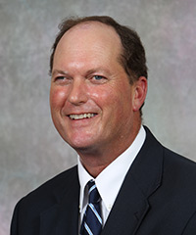

College of Business
Outstanding Professor Award
Kevin Hubbard (TCM)

Slide 46
Daisy Portenier Loucks Professors (2018/2019)
Christina Simmers (MKT)
Carol Miller (FGB)
Ed Chang (FGB)

Slide 47
Looking Ahead to August...
Showcase for Teaching & Learning
Wednesday (8/14) 8:00 am – 1:30 pm PSU
All Faculty Welcome Back Luncheon
Thursday (8/15) 11:30 am – 1:00 pm, PSU Ballroom
All COB
Friday (8/16) 10:00 am – 11:30 am, Glass 108 (Lunch to Follow)
First Day of Classes
Monday (8/19)

Slide 48



TITLE
Content

