Slide 1
All COB Meeting
Spring 2020
David Meinert, Dean
ITC Presentation

Slide 2
Agenda
Announcements Returning to Campus FA20 Career Fairs Accreditation Update Search Updates Budget Outlook – FY21 | China Campus & EMBA COB Retirements All Faculty Recognition COB Awards COB Retirements Shout Outs Looking Ahead to FA20

Slide 3
Thank You
Feedback re transition to alternative delivery
All of my professors in the School of Accountancy did a great job of swiftly transitioning their classes online and providing a lot of guidance and help with the transition.
THANK YOU - All of my teachers in the accounting department!
All my professors have been extremely accommodating and have gone out of their way to ensure that their students feel comfortable not only within our learning environment but in our personal lives as well.
All of my professors and everyone I have talked to since transitioning online have been super supportive during this difficult transition.
All of my professors have been amazing. They've done what they can to help us adjust all while having their own lives turned upside down.
COB is doing great informing the students on things and really helping with the adjustment to online classes

Slide 4
Thank You
Feedback re transition to alternative delivery
All my professors in the Finance department have been very prompt and extremely adaptive and they should be commended for their efforts.
All my professors have been extremely accommodating and have gone out of their way to ensure that their students feel comfortable not only within our learning environment but in our personal lives as well.
All of my professors and everyone I have talked to since transitioning online have been super supportive during this difficult transition.
All of my professors have been amazing. They've done what they can to help us adjust all while having their own lives turned upside down.
COB is doing great informing the students on things and really helping with the adjustment to online classes

Slide 5
Thank You
Feedback re transition to alternative delivery
I'm a graduate assistant for the Management Department and the professors I work for (Dr. Haggard, Mr. Pace, and Dr. Shao), Teresa (the administrative assistant), and Dr. DeBode have all been very helpful and kind during this time.
The Management Department at in the College of Business has worked with me a lot in general in getting things transitioned. I am a graduate assistant, and I really appreciated their guidance during this time, especially Ms. Teresa Carl.
All my professors have been extremely accommodating and have gone out of their way to ensure that their students feel comfortable not only within our learning environment but in our personal lives as well.
All of my professors and everyone I have talked to since transitioning online have been super supportive during this difficult transition.
All of my professors have been amazing. They've done what they can to help us adjust all while having their own lives turned upside down.
COB is doing great informing the students on things and really helping with the adjustment to online classes

Slide 6
Thank You
Feedback re transition to alternative delivery
All of my professors in the TCM department are doing a pretty good job.
Most construction management teachers have transitioned well.
All my professors have been extremely accommodating and have gone out of their way to ensure that their students feel comfortable not only within our learning environment but in our personal lives as well.
All of my professors and everyone I have talked to since transitioning online have been super supportive during this difficult transition.
All of my professors have been amazing. They've done what they can to help us adjust all while having their own lives turned upside down.
COB is doing great informing the students on things and really helping with the adjustment to online classes

Slide 7
Thank You
Feedback re transition to alternative delivery
All my professors have been extremely accommodating and have gone out of their way to ensure that their students feel comfortable not only within our learning environment but in our personal lives as well.
All of my professors have been amazing. They've done what they can to help us adjust all while having their own lives turned upside down.
COB is doing great informing the students on things and really helping with the adjustment to online classes

Slide 8
Announcements
FCTL VIRTUAL Online BOOTCAMPS
  Two SU20 Online Bootcamps
    June 15-26
    July 13-24
  For more information contact the FCTL@MissouriState.edu or visit the FCTL website. Please register through My Learning Connection by searching for “Two Week Virtual Online Boot Camp”.

Slide 9
Announcements
Virtual town Hall meeting
When: 10:30 a.m., Wednesday, May 20
Where: Zoom
Who: MSU leadership team; Missouri State faculty, staff and students
What:
  Plans to Reopen Campus
  FY2021 Budget Update
  Questions or comments

Slide 10
Announcements
Travel Restrictions continue thru June 30
The university is suspending all university-related and sponsored travel that exceeds 150 miles.
This applies to university travel for all faculty, staff and students located in southwest Missouri. Exceptions may be approved by the university provost or president.
The time frame will be revisited as warranted.

Slide 11
Announcements
Stay engaged over the Summer
Clif’s Notes
Inside COB

Slide 12
Announcements
New Faculty Summer Research support
New faculty receiving summer research support are required to submit a memo to their department head detailing their research activities from the summer by October 1, 2020.

Slide 13
Transitioning Back to Campus
Phased approach
  Slowly Ease Restrictions on Campus Community
  Buildings Expected to Remain Closed Thru June 30
    COB Offices remain closed until late June
    Faculty and staff continue to work remotely as much as possible
    Faculty and staff may return to offices/labs on a limited basis
  COB Offices will be open starting July 1
    Reduced Office Staffing - Flex schedules and telecommuting will continue
    Social distancing will be the norm
    Faculty continue to work remotely as much as possible

Slide 14
Looking To The Fall Semester
From clif’s note (5/5)
More classes than usual will be offered online or in a hybrid format.
Faculty are engaging in training to ensure all virtual classes are delivered in a quality manner with high academic rigor.
We are encouraging all faculty members to have contingency plans in place to deliver their classes virtually should the need arise.
We will adopt and strongly encourage social distancing practices in classrooms, residence halls, and dining and gathering spaces on campus.
Some campus events will be canceled and others adjusted to reduce size and enable social distancing.
We are designing a new housing strategy that will accommodate this new mode of campus living.

Slide 15

Fall 2020 COB Career Fairs
Accounting Career Fair
Wednesday, September 9, 2020
12:00 - 3:00 pm
University Plaza Hotel
College of Business Career Fair
Tuesday, September 15, 2020
10:00 am - 2:00 pm
Springfield Expo Center
Career Fair Plus App
FREE!
There will be no workshop waivers granted for fall 2019 fairs. All students must attend a Prepare for the Fair workshop.

Slide 16
AACSB Accreditation update and timeline
2017-2018 Internal Annual Report
2018-2019 Internal Annual Report
2019-2020 Internal Annual Report
2020-2021 Internal Annual Report
2021-2022 Self-Study Year
2022-2023 Preparation & Submission of Report
Peer Review Team Visit
2020 Business Accreditation Standards
Virtual Vote In-Progress
https://www.aacsb.edu/accreditation/about-the-batf

Slide 17
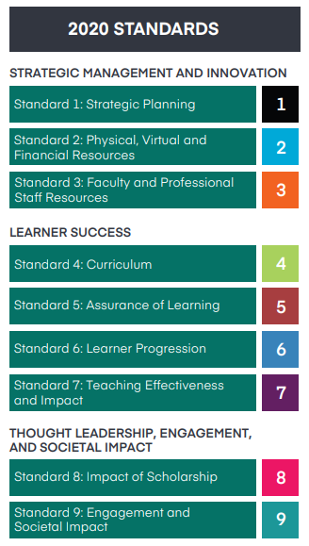
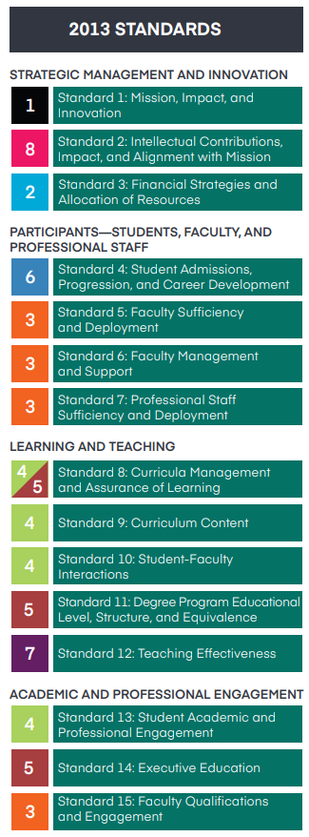
2020 Business Accreditation Standards

Slide 18
Search Updates
Director, School of Accountancy
  Dr. Kimberly Swanson Church will be joining us July 1
Assistant Professors
  MKT Dr. Gawon Yun
  MGT Dr. Kathy Adler
  FGB Dr. Megan Rainville
Instructor
  ITC Mr. Jason Speer

Slide 19
MSU Budget Outlook FY21
State Budget flat funding for Higher Education
  Conditional upon federal government extending Medicaid stimulus program
  Withholds are likely as budget reflects higher than expected revenues
BOG Expected To Support Full Tuition Increase
Open Positions Frozen for One Year (limited exceptions)
Enrollment Challenging To Forecast (indicators are mixed)
Budgeting scenarios range from $10-$20M shortfall

Slide 20
China Campus & EMBA
China Campus
  FA20 Record Jr class – upwards of 180 students
  70+ students expected to defer transferring MSU
    Primarily students interested in accounting and finance
    Expected to take FA20 online classes w/ goal of transferring SP21
  EMBA
    Two majors sponsors are deferring applications until at least January 2021
    New cohort for FA20 unlikely

Slide 21
COB Retirements
Geanie Margavio (SOA) Associate Professor, 8/1990 – 7/31/2020
Deb Oden (SOA) Professor, 8/1989 – 5/31/2020
Carole Hale (SOA) Administrative Assistant II, 10/1998 – 6/30/2020
Susan Crain (FGB) Professor, 8/2001 – 7/31/2020
Tom Margavio (ITC) Professor, 8/1990 – 7/31/2020
Sherry Cook (MKT) Senior Instructor, 8/1998 – 7/31/2020
Glenn Pace (MGT) Senior Instructor, 8/2006 – 7/31/2020
Steve Thomas (MGT) Professor, 8/1990 – 1/31/2020

Slide 22
COB Retirements
Geanie Margavio (SOA) Associate Professor, 1990 – 2020
Deb Oden (SOA) Professor, 1989 – 2020
Carole Hale (SOA) Administrative Assistant II, 1998 – 2020
Susan Crain (FGB) Professor, 2001 – 2020
Tom Margavio (ITC) Professor, 1990 – 2020
Sherry Cook (MKT) Senior Instructor, 1998 – 2020
Glenn Pace (MGT) Senior Instructor, 2006 – 2020
Steve Thomas (MGT) Professor, 1990 – 2020

Slide 23
All Faculty Recognition
Foundation Awards
Foundation Award for Teaching
Kent Ragan (COB)
Foundation Award for Research
Carol Miller (FGB)

Slide 24
All Faculty Recognition
Years of Service Awards
10 Years
Samuel Bass (ACC)
15 Years
Stanley Leasure (FGB)
James Philpot (FGB)
20 Years
Vinay Garg (MGT)
30 Years
Tanya Barrier (ITC)
Rajeev Kaula (ITC)
Geanie Margavio (ACC)
Tom Margavio (ITC)
Allen Schaefer (MKT)
Steve Thomas (MGT)
Dick Williams (ACC)
35 Years
Dane Peterson (ITC)

Slide 25
COB Awards

Slide 26
Awards
Outstanding Research Paper (2 awards)
COB Faculty Scholarship and Awards Committee
SOA Chris Hines
FGB Jenny Zhang
ITC S Brahnam
MGT Feibo Shao
MKT Josh Coleman
MFD Sandy Bailey

Slide 27
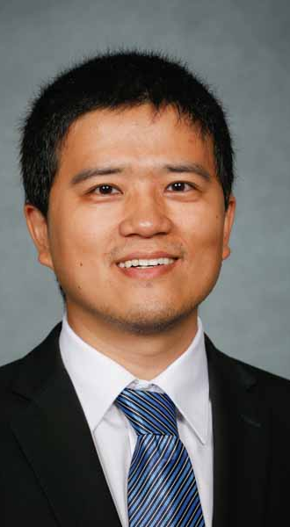
Award Winners
Outstanding Research PaperS
LinDa (Jackson) Li (MKT)
Best Non-Empirically Based Research Paper

Slide 28
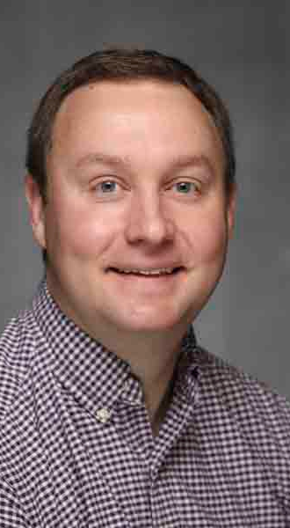
Award Winners
Outstanding Research PaperS
Wes Friske (MKT)
Best Empirically Based Research Paper

Slide 29
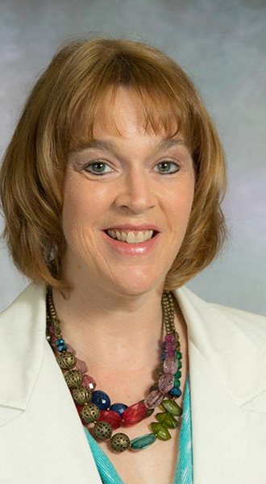
Award Winners
Outstanding Advisor
Alisa Trotter (BAC)
COB Outstanding Academic Advisor

Slide 30
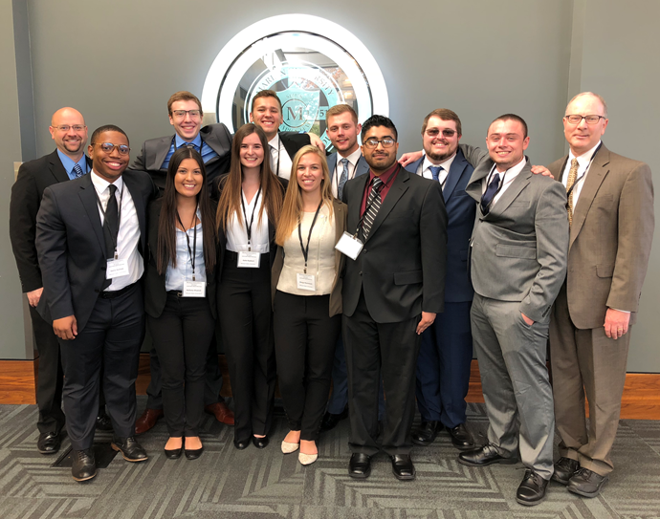
Award Winners
COB Outstanding Faculty Award
Michael Merrigan (MGT)
COB Outstanding Faculty Award
Nominated by
MBA Association and Future Healthcare Leaders
Selected by
COB Student Leadership Council

Slide 31
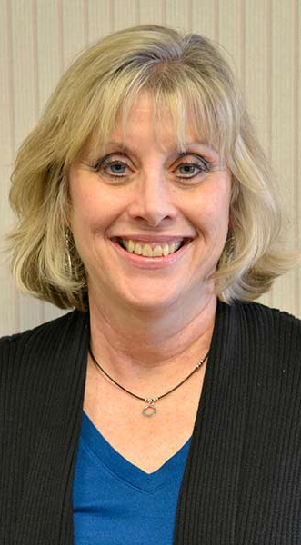
Award Winners
Outstanding Service Award
Janet Davis
COB Outstanding Service Award

Slide 32
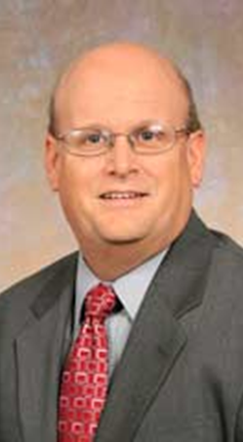
Thank You
Dr. Dick Williams
SOA Director
2005-2020

Slide 33
Shout-Outs
Departmental
Richard Gebken
International Outstanding Educator Award
Associated Schools of Construction
Josh Davis
Technology Executive of the Year
Biz 417 Magazine Excellence in Technology Awards
FBLA-PBL - Faculty Advisor – Courtney Pham
  State Competition - 7 First Place Finishes & 32 Top 10 Finishes
RIMS, the risk management society®
  Anita Benedetti Student Involvement Program (ABSIP) Scholars (2 of 30)
  President’s CPCU Scholarship (2 of 100)

Slide 34
Looking Ahead to August...
Canceled Events
  Showcase for Teaching & Learning
  Welcome Back Luncheon
  New Faculty Receptions
  COB Kickoff Luncheon
All COB (TBD Friday 8/14, virtual or by department)
First Day of Classes - Monday (8/17)

Slide 35



TITLE
Content

