Slide 1
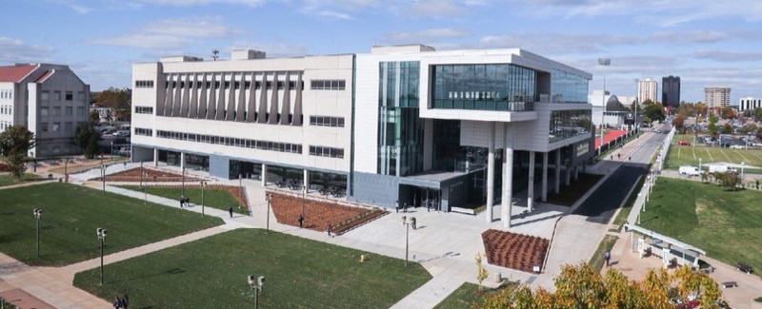
All COB Meeting
Fall 2021
David Meinert, Dean
August 20, 2021

Slide 2
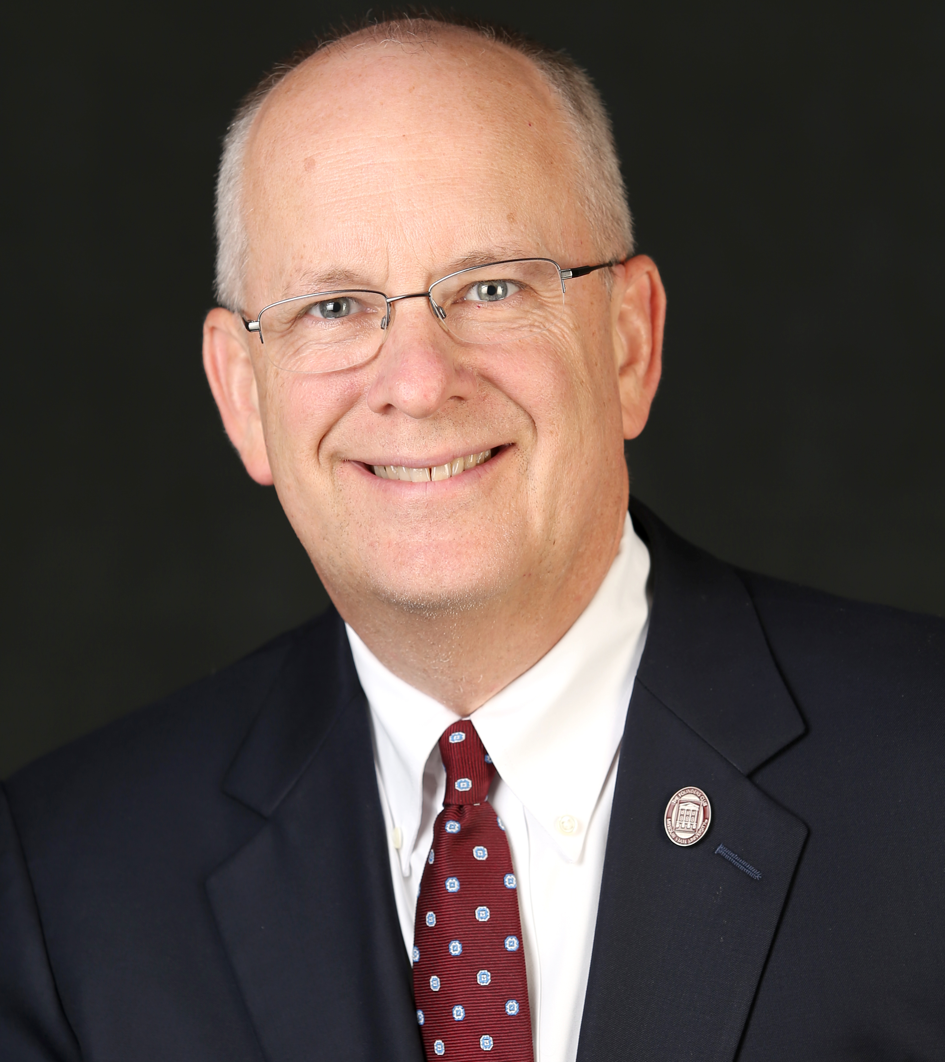
Special Guest
President Clif Smart

Slide 3
Agenda
President Smart
Welcome New Colleagues
Student Success Stories
COB Career Fairs
Personnel & Search Updates
Technology & Building Updates
AACSB Updates
COVID-19 Updates
Department Shout-Outs

Slide 4
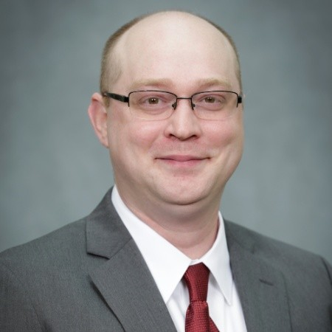
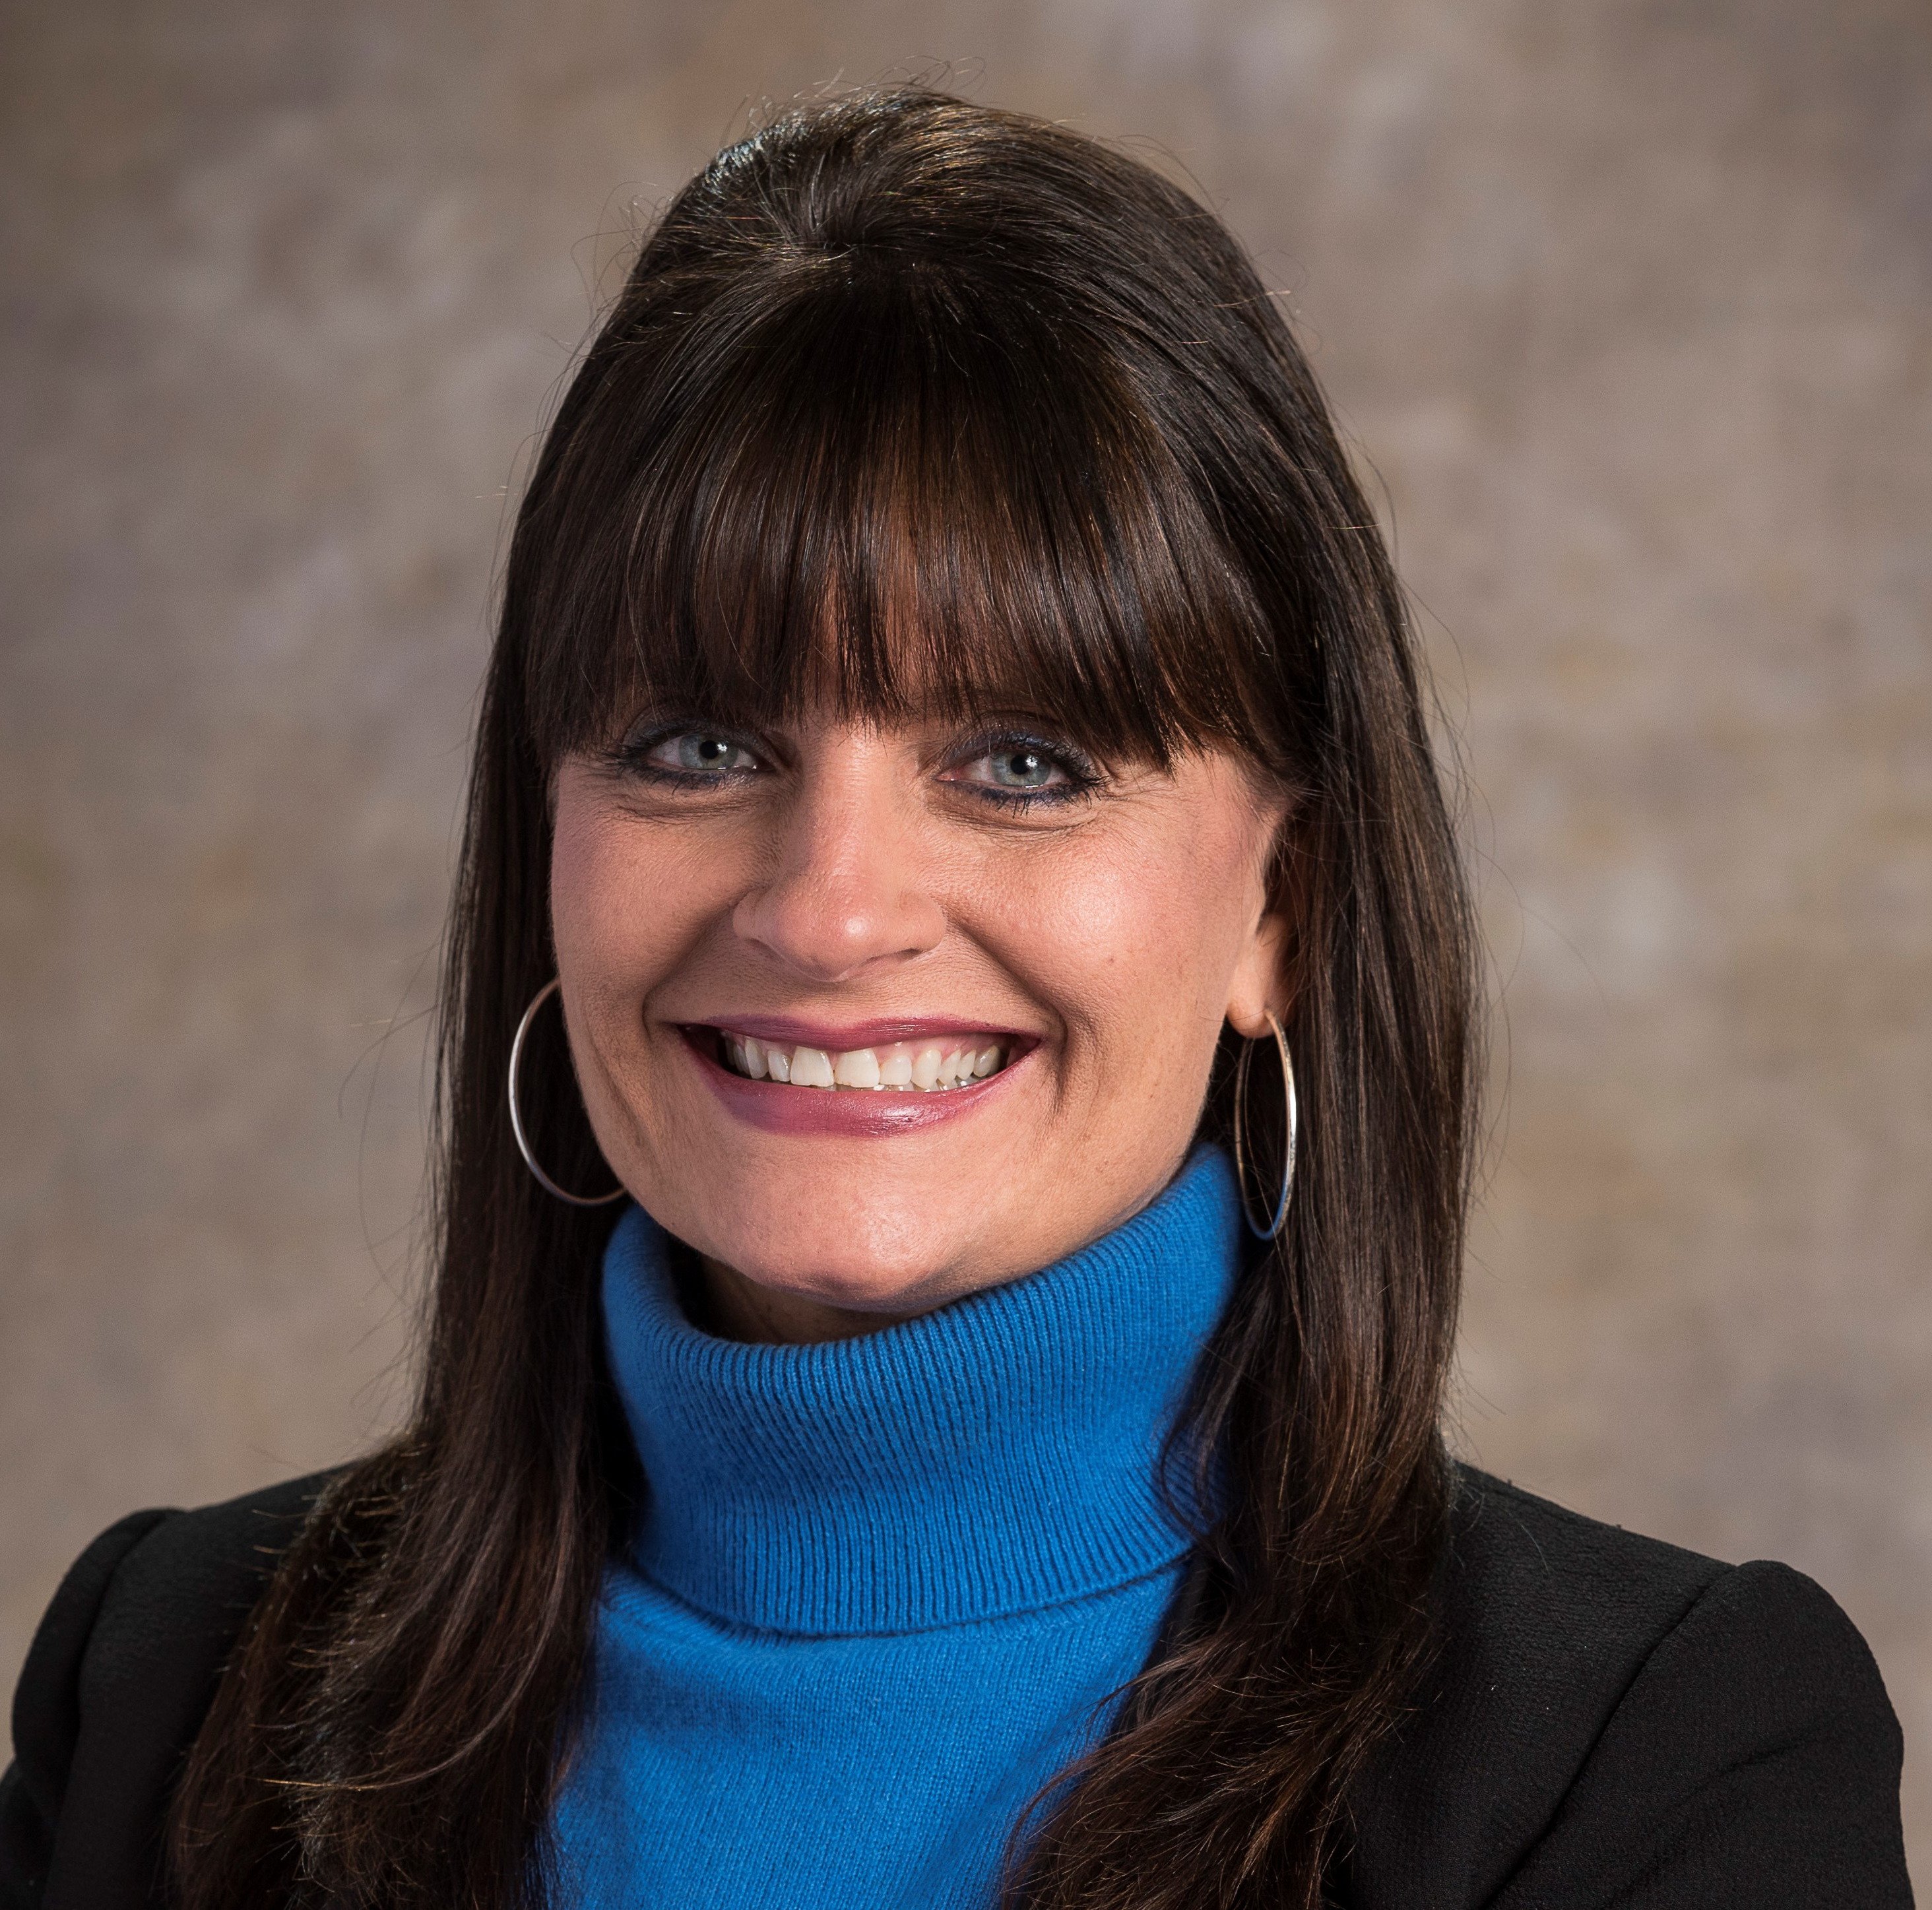
New Colleagues
School of Accountancy
  Kyle Goodin, MAcc, Missouri State University
  Instructor
  CFE
Finance and General Business
  Sandy Meyers, MBA, Drury University
  Clinical Assistant Professor of Risk Management
  27 years in accounting/finance, information technology
  & risk management
  CPA, CPCU, ARM-E, AINS

Slide 5
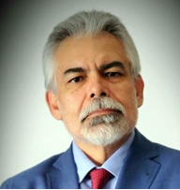
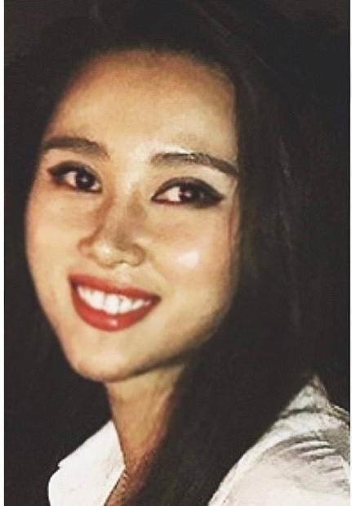
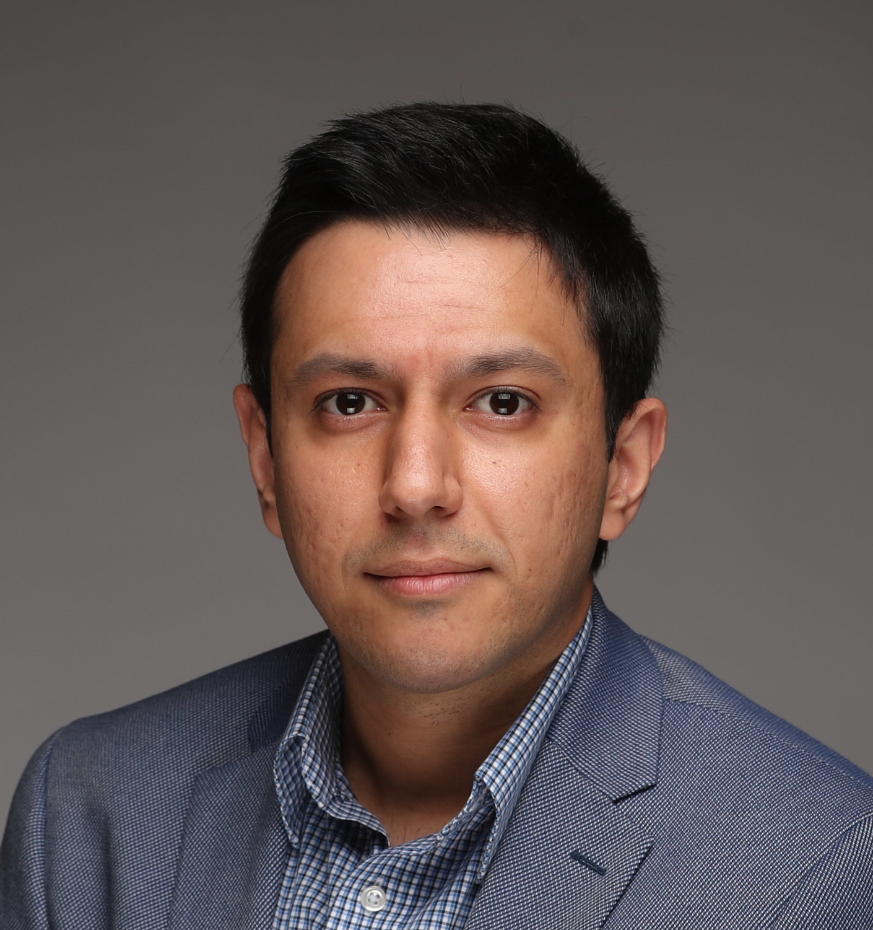
New Colleagues
Management Department
  Luis Perez-Batres, Ph.D., Texas A&M University
  Professor and Department Head
  Strategic Management
  Six years as Chair of the Department of Management
  Central Michigan University
  Lu Yu, Ph.D., University of Wisconsin – Milwaukee
  Assistant Professor
  Organizational Behavior and Human Resources
  Pouya Derayati, Ph.D., University of Miami
  Visiting Assistant Professor
  Strategy

Slide 6
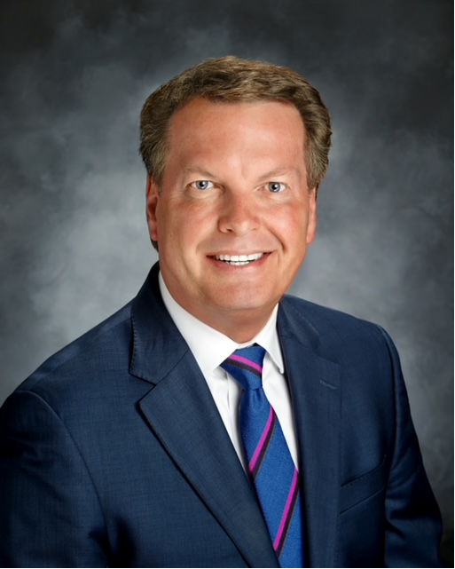
Executive-in-Residence
Robert “ROB” Fulp
MSU Alumnus – finance and banking
40+ years in the banking sector
Last 10 years as CEO of Springfield
First Community Bank
Office in Glass 400
Supporting COB, eFactory, JVIC and the MSU Foundation
Assisting COB with:
  Outreach to the Business Community
  Career Readiness and Mentoring
  Alumni/Supporter Relations

Slide 7
Student Success Stories

Slide 8

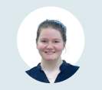
FBLA- PBL National Competition
Faculty Advisor – Courtney Pham
Angelia Ashberger
Accounting Major
First Place
Entrepreneurial Concepts
Madison Agee
Management Major
Sixth Place
Marketing Concepts
&
Ninth Place
Management Concepts

Slide 9
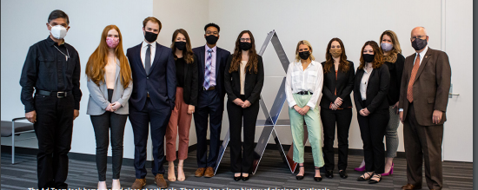
AD Team
Instructor/Advisor – Samantha Francka
Finished in 2nd Place and earned a $3,000 prize in the Invent2Prevent competition, sponsored by the Department of Homeland Security and conducted by EdVenture Partners.

Slide 10


SOA
Beta Alpha Psi & Accounting Club
BAP Chapter achieved Superior Status for FY21
  Faculty Advisors – Carl Keller & George Schmelzle
Accounting Club received the Bronze Certificate
of Excellence for 2021
  Faculty Advisors – Chris Hines & Jim Hines

Slide 11
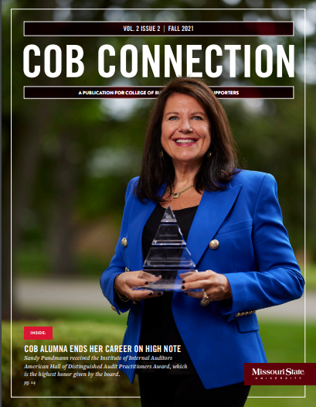
COB CONNECTION
Stories of Success Across The COLLEGE

Slide 12

Help Us Build Your Brand
Promoting COB Success stories
COB > Faculty Resources and Policies -> Other Resources -> COB Faculty, Staff, and Student Recognition Form

Slide 13

Fall 2021 COB Career Fairs

Slide 14
COB Career Fairs
Faculty assistance
Promote via Bb Announcement (provided in upcoming INSIDE COB)
Recommend student participation
Encourage early completion of virtual “Prepare for the Fair” Training
Increase participation by canceling classes
  SOA Career Fair – Wednesday (9/8)
    All SOA courses with start times between 11:00 AM and 2:59 PM are cancelled
  COB Career Fair – Tuesday (9/14)
    All COB courses, except ACC, with start times between 9:30 AM and 1:59 PM are cancelled
    .

Slide 15
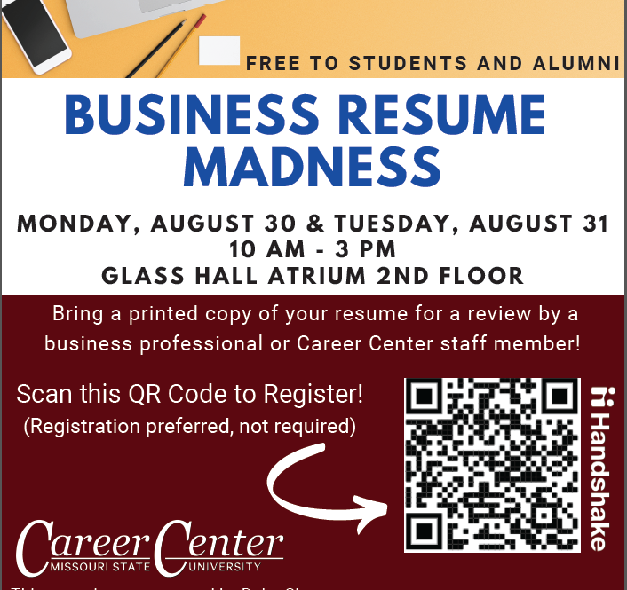
Business Resume Madness
Monday, august 30 & Tuesday August 31 10 Am – 3 PM

Slide 16
Personnel & Search Updates

Slide 17
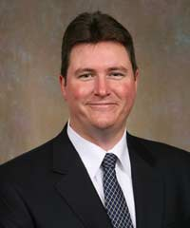
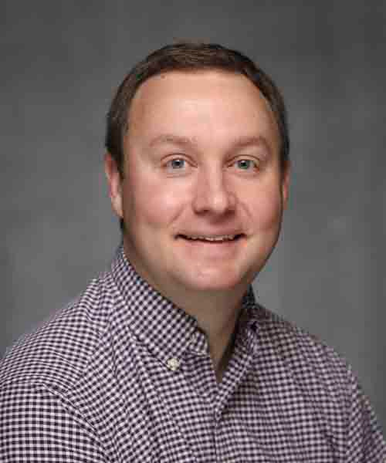
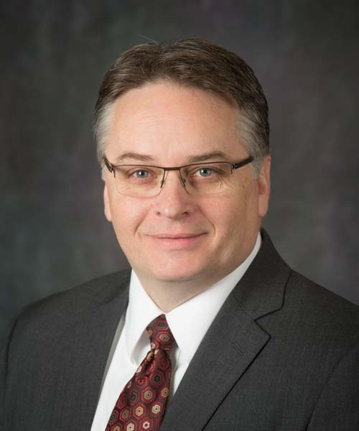
Tenure and Promotion
Ron Clark (MKT)
Promotion to Professor
Wes Friske (MKT)
Tenure and Promotion to Associate Professor
Rick Brattin (ITC)
Tenure and Promotion to Associate Professor

Slide 18
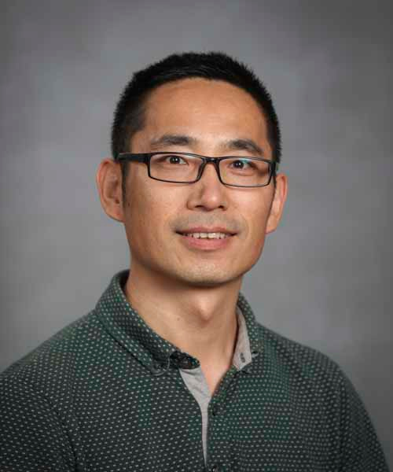
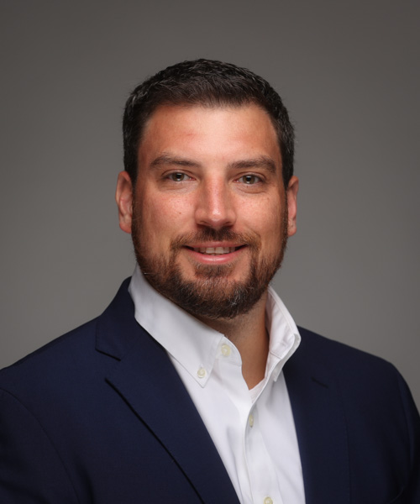
Tenure and Promotion
Zhiguo “Lawrence” Yang (ITC)
Tenure and Promotion to Associate Professor
Seth Hoelscher (FGB)
Tenure and Promotion to Associate Professor

Slide 19
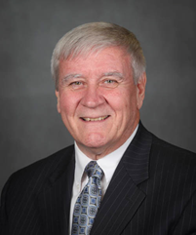
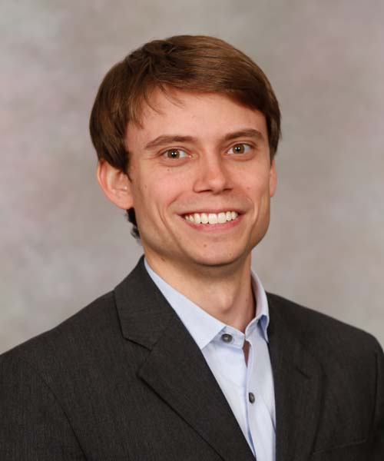
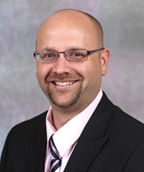
Tenure and Promotion
Russ Meek (FGB)
Promotion to Senior Instructor
Andrew Albritton (MGT)
Promotion to Senior Instructor
Dana Frederick (MGT)
Promotion to Senior Instructor

Slide 20
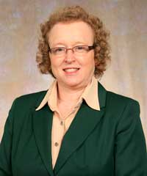
Summer Retirements
Tonya Barrier
Professor
ITC
31 Years

Slide 21
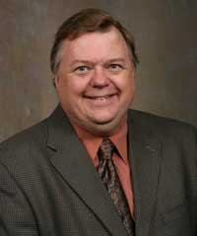
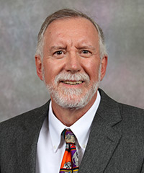
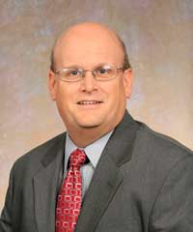
Forthcoming Retirements
Fa21 will BE THEir “Swan song”
Walt Nelson
Associate Professor
FGB
32 Years
Michael Hammond
Senior Instructor
SOA
19 Years
Dick Williams
Associate Professor
SOA
32 Years

Slide 22
Faculty & Staff Updates
Dr. Julie Ravenscraft accepted a clinical faculty position with Arizona State University
Melissa Price left MSU in June to pursue a new opportunity
Kim Cook recently accepted a new position and is no longer with MFD
Stef Hall will be joining Student Affairs Multicultural Office effective Monday, August 23

Slide 23
FA21 Searches
Assistant Professor (SOA)
Assistant Professor (FGB)
Clinical Assistant Professor (FGB)
Assistant Professor (MGT)
Assistant/Associate Professor (MKT)
Department Head and Associate Professor/Professor (ITC)
Director of Marketing, Communications and External Relations (COB)
Academic Administrative Assistant II (MFD/GRAD PROG)
Academic Administrative Assistant II (MGT)

Slide 24
General Announcements

Slide 25

University Safety
Be prepared
Add (417) 836-5509 to your contacts
Manage your Missouri State Alert preferences

Slide 26
Research Grants
Faculty Research Grants (up to $7,500)
Submit proposal to the Graduate College by October or February
Faculty Summer Research Fellowship ($6,000) Submit proposal to the Graduate College by October
Faculty Research Opportunities can be found at https://www.missouristate.edu/provost/orientation/fundingsupport.htm
See Inside COB for more details

Slide 27

Public Affairs Conference
September 27-30, 2021
Mix of In-person Events and Live Virtual Programming
Conference Schedule:
https://publicaffairs.missouristate.edu/conference/schedule
Zoom Webinar links will be listed on the schedule

Slide 28
BAC ADVISING
Undergraduate Students
Requests to Add closed sections
  Direct students to complete the Override Request (for College of Business Courses
  Only) from the Business Advisement Center website. The direct link is: https://www.missouristate.edu/BusAdv/override-request.htm
  The student clicks on their advisor’s name and then completes the form.
  Upon submission, the request will route to their advisor.
Issues with schedule/modality changes
  Direct students to contact their assigned advisor

Slide 29
Technology & Building Updates
Kent Ragan, Associate Dean

Slide 30
Computer & Telephone Updates
New Faculty & Staff Dell AIOs will be installed during the fall semester
Networking and Telecommunications will be installing VOIP phones
Need a classroom webcam? Contact COB Computing

Slide 31
Glass Hall
Building Access
Building Hours
  Monday -Thursday, 7:30 am to 9:00 pm
  Friday, 7:30 am to 6:00 pm
  Sunday, Noon to 9:00 pm*
  Closed Saturdays and University holidays
If you see something amiss in the building, contact University Safety – (417) 836-5509
BearPass access 24x7
  Access issues – contact Janet Davis
* COB Computing Staff onsite monitoring the building

Slide 32
Construction Update
Glass 432 and 433 complete (carpet/tables not updated)
Glass 430 and 431 being remodeled now/fall
New lighting in Glass 346 and 435
Computers carts now digital with new floor boxes – use wall screens since
motorized screens have been inactivated or removed. The new projectors
are focused on the wall screens now.
Exploring additional classroom remodeling – depending on south elevator
costs and other funding issues

Slide 33
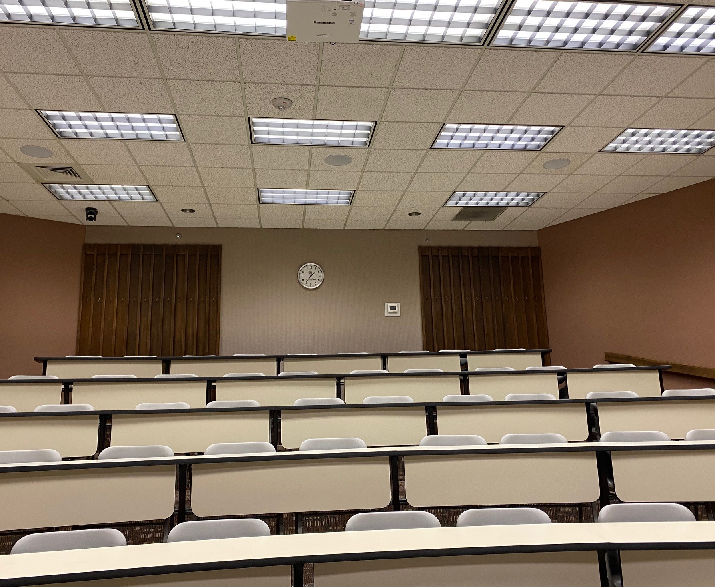
Transforming Our Learning Space
Fall1987-2020

Slide 34
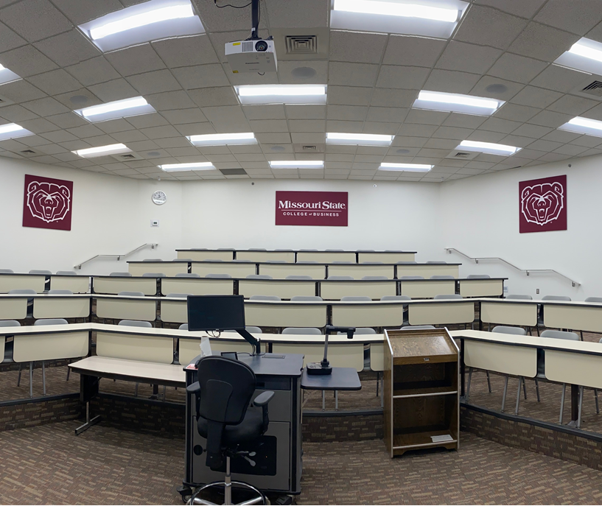
Transforming Our Learning Space
Fall 2021

Slide 35
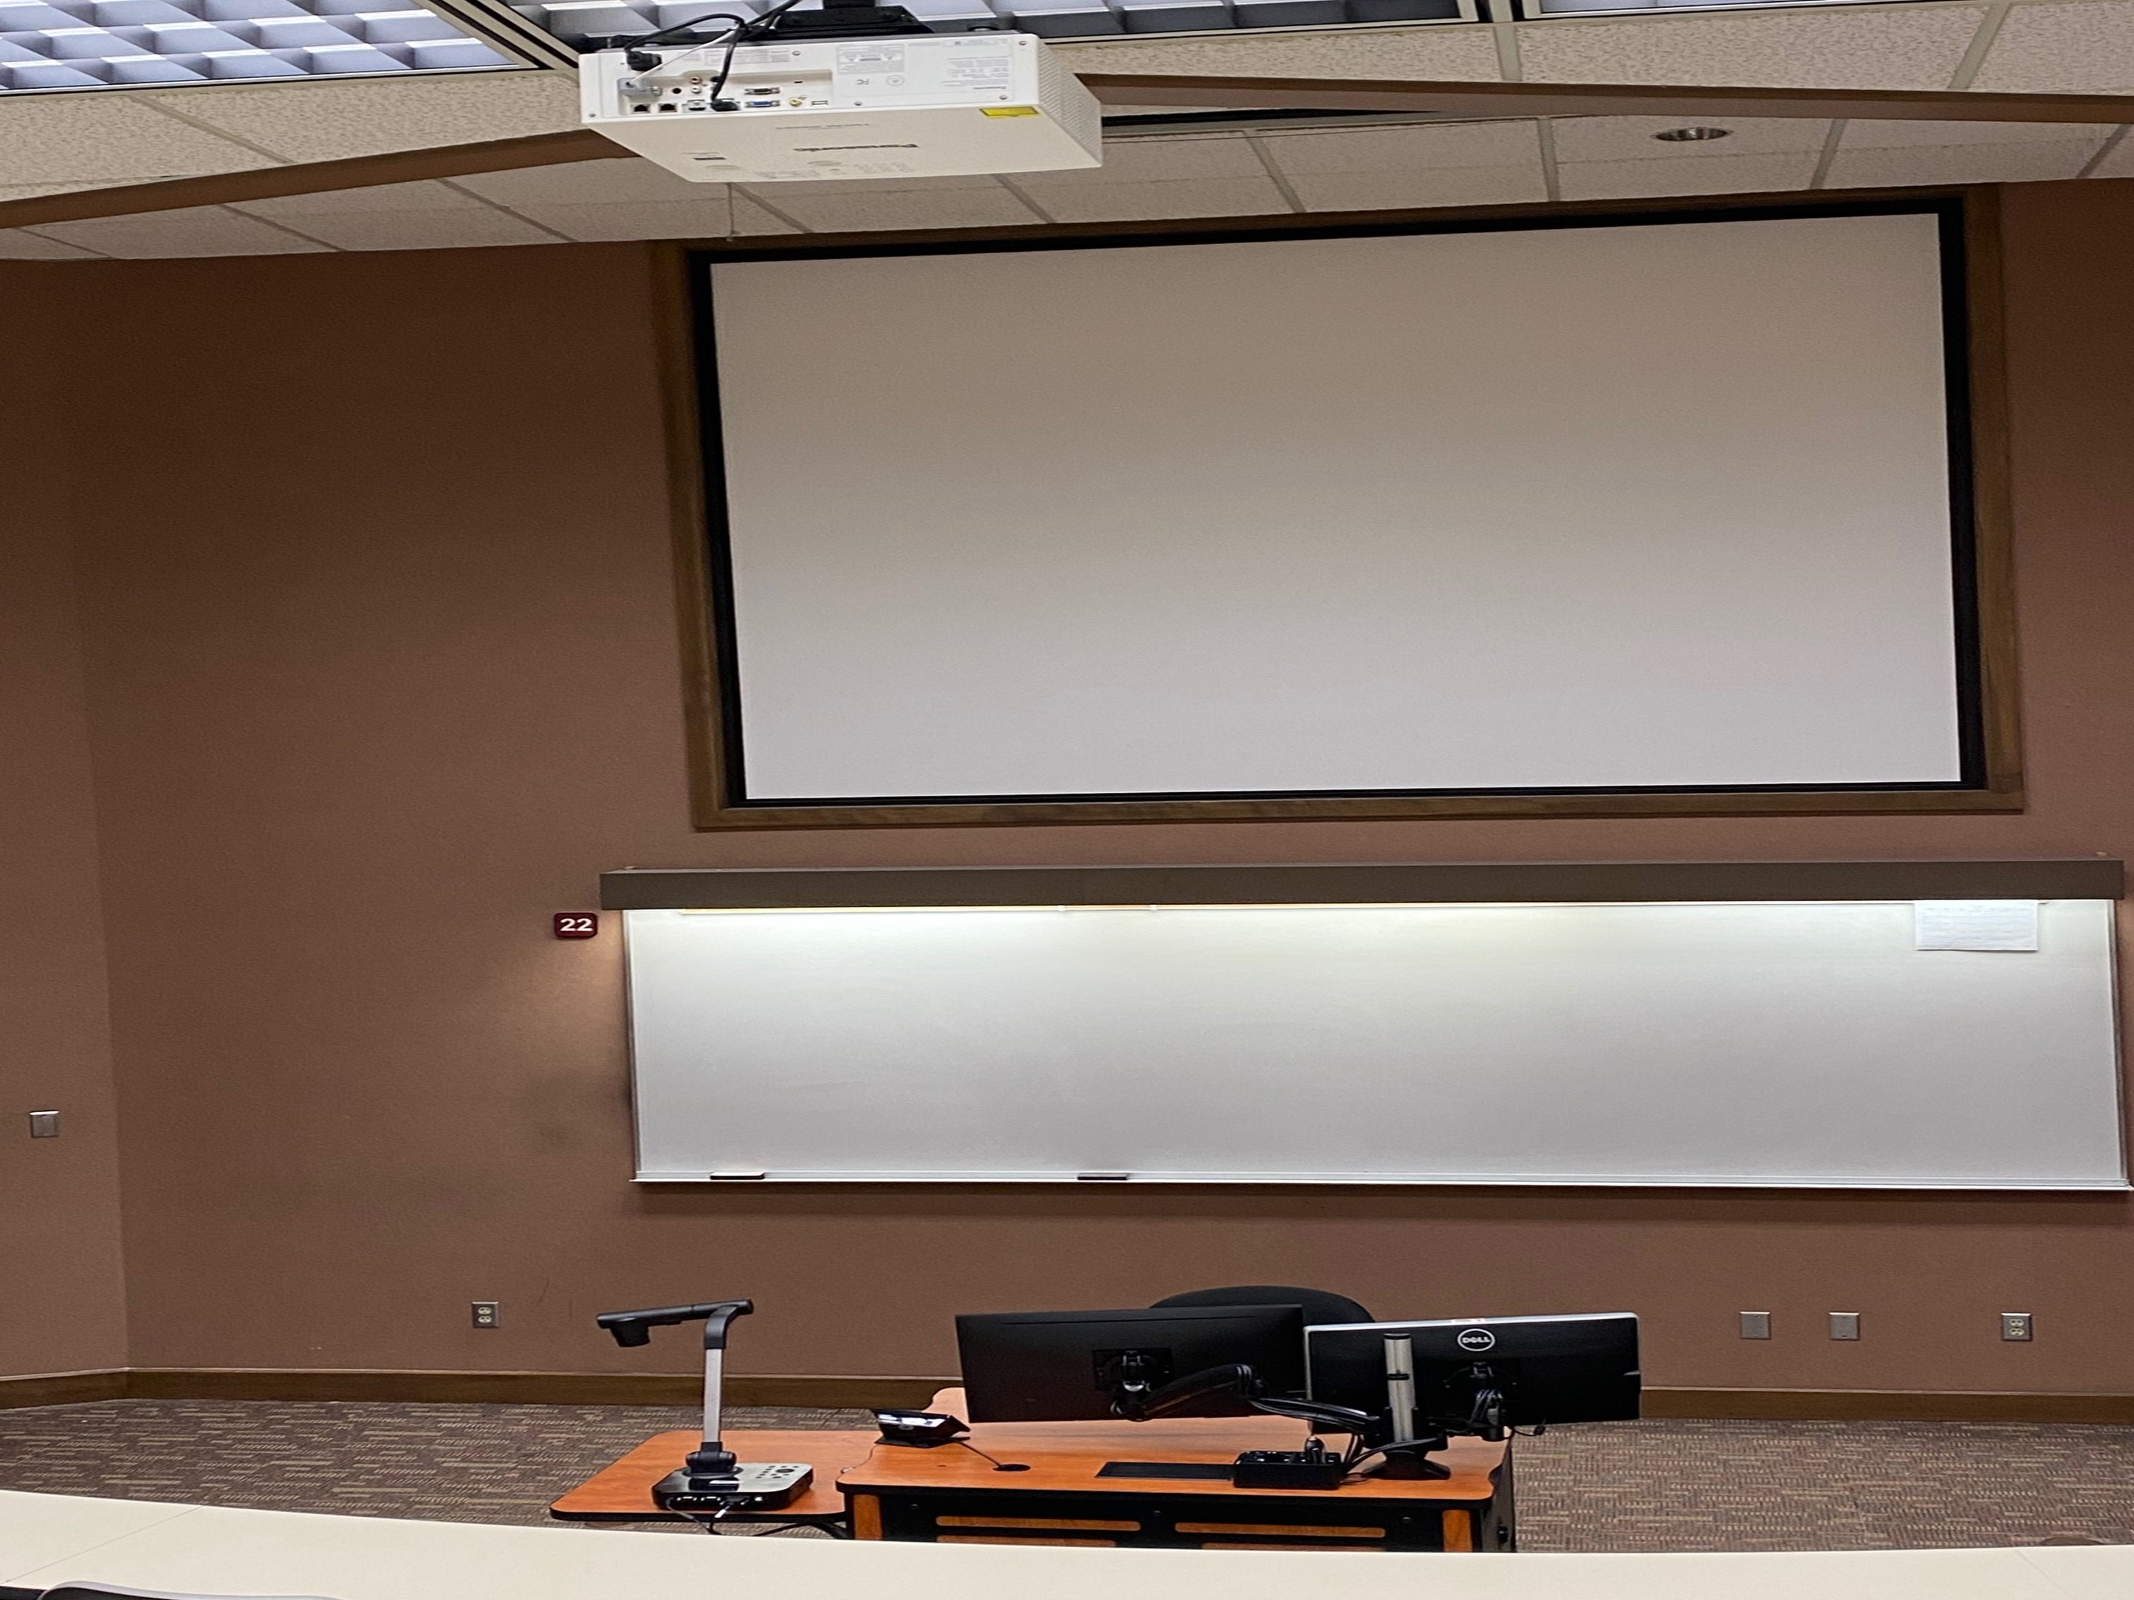
Transforming Our Learning Space
Fall1987-2020

Slide 36
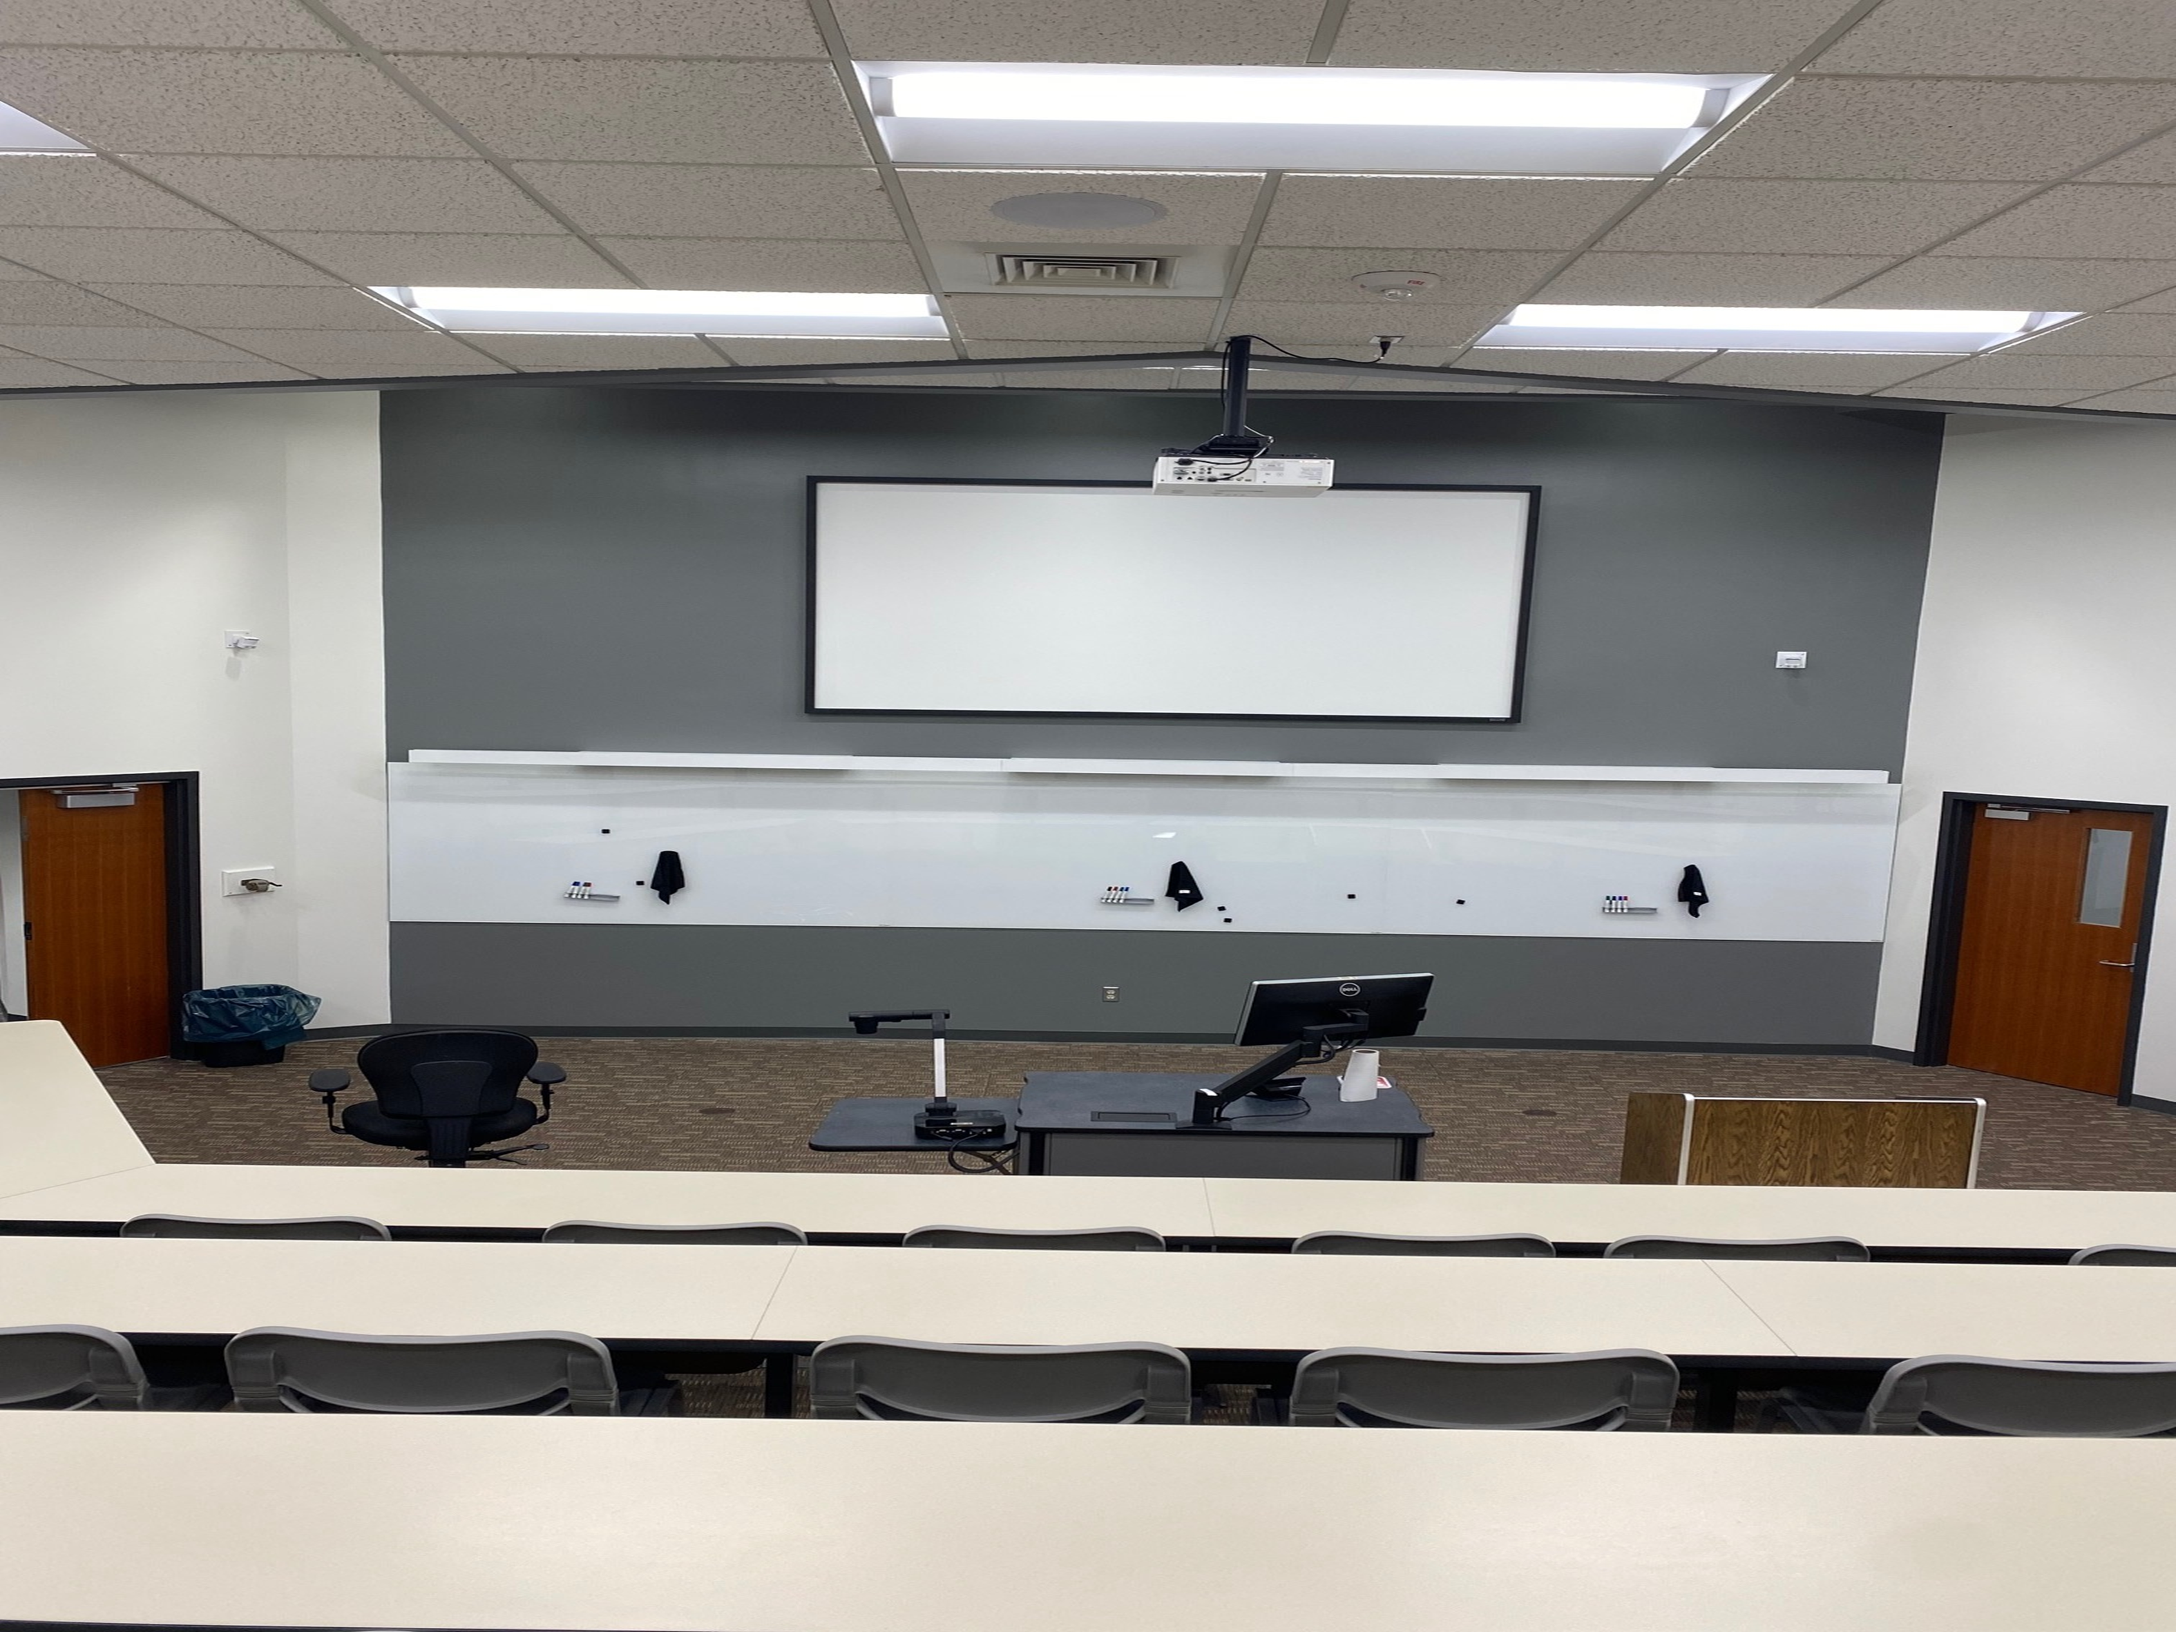
Transforming Our Learning Space
Fall 2021

Slide 37
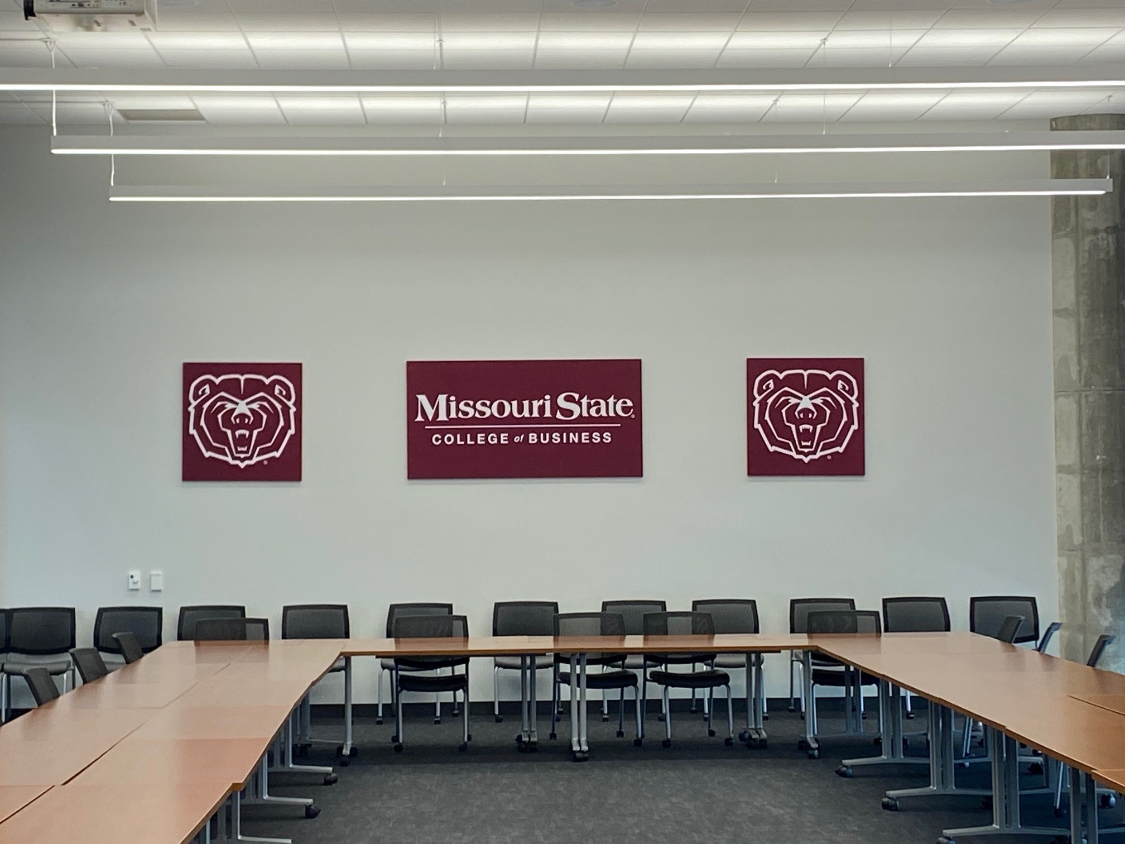
New COB Photo Background
Glass 486

Slide 38
Education Abroad
Formerly Study Away
Student interest is high so programs are needed
Michelle Hulett: Ireland during spring break
Mike Merrigan: Berlin and Prague in May
Kent Ragan: London, Paris, Brussels, Amsterdam in August

Slide 39
AACSB Updates
Libby Rozell, Associate Dean

Slide 40
AACSB
Continuous Improvement Review (CIR) Timeline
2017-2018 Internal Annual Report
2018-2019 Internal Annual Report
2019-2020 Internal Annual Report
2020-2021 Internal Annual Report
2021-2022 Self-Study Year
2022-2023 Preparation & Submission of CIR Report
CIR Peer Review Team Visit

Slide 41
Key Changes in AACSB Standards
Removed current requirement of 60% SA+PA+SP faculty, leaving expectation that 40% in a discipline and overall will be SA and 90% SA+PA+SP+IP in a discipline and overall globally.
Discipline is the default reporting unit;
Schools define the disciplines
Faculty are reported in the discipline in which they teach
Ratios are met at the discipline level, so SA percentages are not by degree program. (More principles based, more flexible, NOT LESS RIGOROUS)

Slide 42
Key Changes to AACSB Standards
IMPACT of Scholarship
  IMPACT is king. We want to move towards outcomes being the most important indicator of quality. That is, how are the intellectual contributions being used.
Some ICs in the portfolio should demonstrate positive societal impact

Slide 43
Faculty Qualification Forms
Captured fantastic information from this year’s forms
FORMS ARE VERY IMPORTANT THIS YEAR!
Need to show our activities relative to our university mission—PUBLIC AFFAIRS

Slide 44
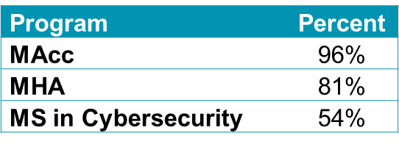
Percent of Participating Faculty: 2020-2021
By Discipline
By Specialized Master’s Program
Discipline | Percent
Accounting | 93.6%
Business Law | 61.5%
Finance | 88.9%
Information Technology | 82.4%
Management | 77.3%
Marketing | 93.3%
Statistics | 96.3%
COB TOTAL | 85.6%

Slide 45
Faculty Qualifications Percentages by Discipline: 2020-2021
Discipline | SA (≥40%) | PA | SP | IP | SA+PA+SP+IP (≥90%)
Accounting | 64.5% | 6.4% | 6.4% | 16.2% | 93.6%
Business Law | 76.0% | 0.0% | 0.0% | 24.0% | 100.0%
Finance | 76.8% | 3.3% | 0.0% | 13.3% | 93.4%
Information Technology | 52.5% | 7.3% | 5.3% | 29.7% | 94.7%
Management | 72.8% | 10.3% | 4.8% | 12.1% | 100.0%
Marketing | 71.4% | 0.0% | 0.7% | 22.5% | 94.6%
Statistics | 57.1% | 0.0% | 0.0% | 42.9% | 100.0%
COB TOTAL | 67.3% | 5.0% | 3.2% | 20.5% | 96.0%

Slide 46
AACSB Table 3-2: Deployment of Participating and Supporting Faculty by Qualification Status in Support of
Degree Programs for 2020-2021 Using Student Credit Hours
Program | SA (≥40%) | PA | SP | IP | SA+PA+SP+IP (≥90%)
Bachelor's | 55.39% | 2.12% | 5.47% | 31.90% | 94.88%
MBA | 93.54% | 0.65% | 0.03% | 3.96% | 98.18%
Specialized Master's
MAcc | 73.47% | 9.91% | 12.83% | 3.79% | 100.00%
MHA | 47.77% | 40.89% | 0.00% | 6.48% | 95.14%
MS in Cybersecurity | 43.86% | 0.00% | 0.00% | 56.14% | 100.00%

Slide 47
AACSB Table 8-1: Summary of ICs by Discipline
January 1, 2016 – December 31, 2020
 | Portfolio of Intellectual Contributions |  |  | Types of Intellectual Contributions |  |  | % of Faculty Producing ICs
 | Basic or Discovery Scholarship | Applied Scholarship | Teaching and Learning Scholarship | Peer-reviewed journal articles | Additional peer-reviewed ICs | Other ICs | % of Participating Faculty Producing ICs | % of total FTE faculty producing ICs
Accounting | 18.5 | 55.5 | 37 | 33.5 | 63.5 | 14 | 80.00% | 77.40%
Business Law | 1 | 9 | 5 | 10 | 2 | 3 | 100.00% | 76.00%
Finance | 66.58 | 13 | 29 | 36.58 | 54 | 18 | 85.70% | 85.10%
Information Technology | 46.83 | 18 | 10 | 55.33 | 7.5 | 12 | 75.00% | 63.10%
Management | 43.92 | 25.5 | 10 | 42.92 | 28.5 | 8 | 82.40% | 77.60%
Marketing | 75 | 14 | 7 | 47 | 43 | 6 | 77.80% | 72.10%
Statistics | 6.17 | 0 | 0 | 4.67 | 0.5 | 1 | 40.00% | 38.10%
Total | 258 | 135 | 98 | 230 | 199 | 62 | 78.40% | 72.70%

Slide 48
COVID-19 Updates

Slide 49
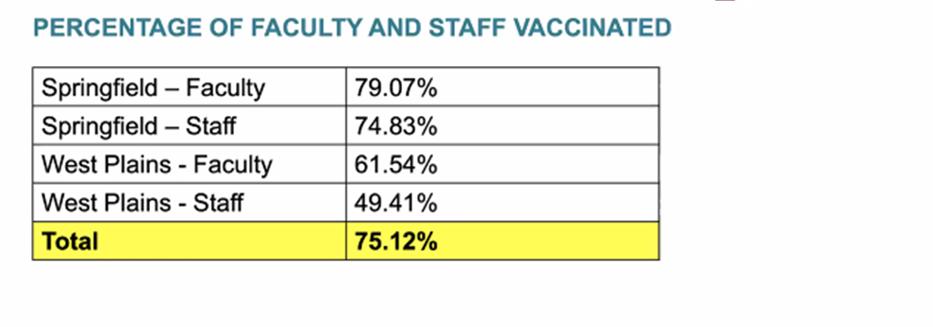
Percentage of Faculty & Staff Vaccinated

Slide 50
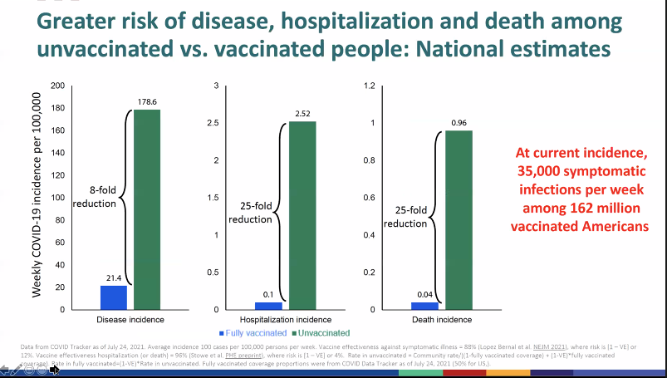

Slide 51
Mitigation Strategies
Vaccinations Magers Health & Wellness Center Incentives (Students & Employees) On-Site (targeted groups & events) | Contact Tracing Quarantine/Isolation/Monitoring Change course modality for brief periods with Dept Head & Dean approval
Testing Move-in High-Risk Groups Asymptomatic surveillance Wastewater surveillance | KN95/N95 Masks
COVID Housing Kentwood Hotels Wells, Woods, & Hutchens

Slide 52
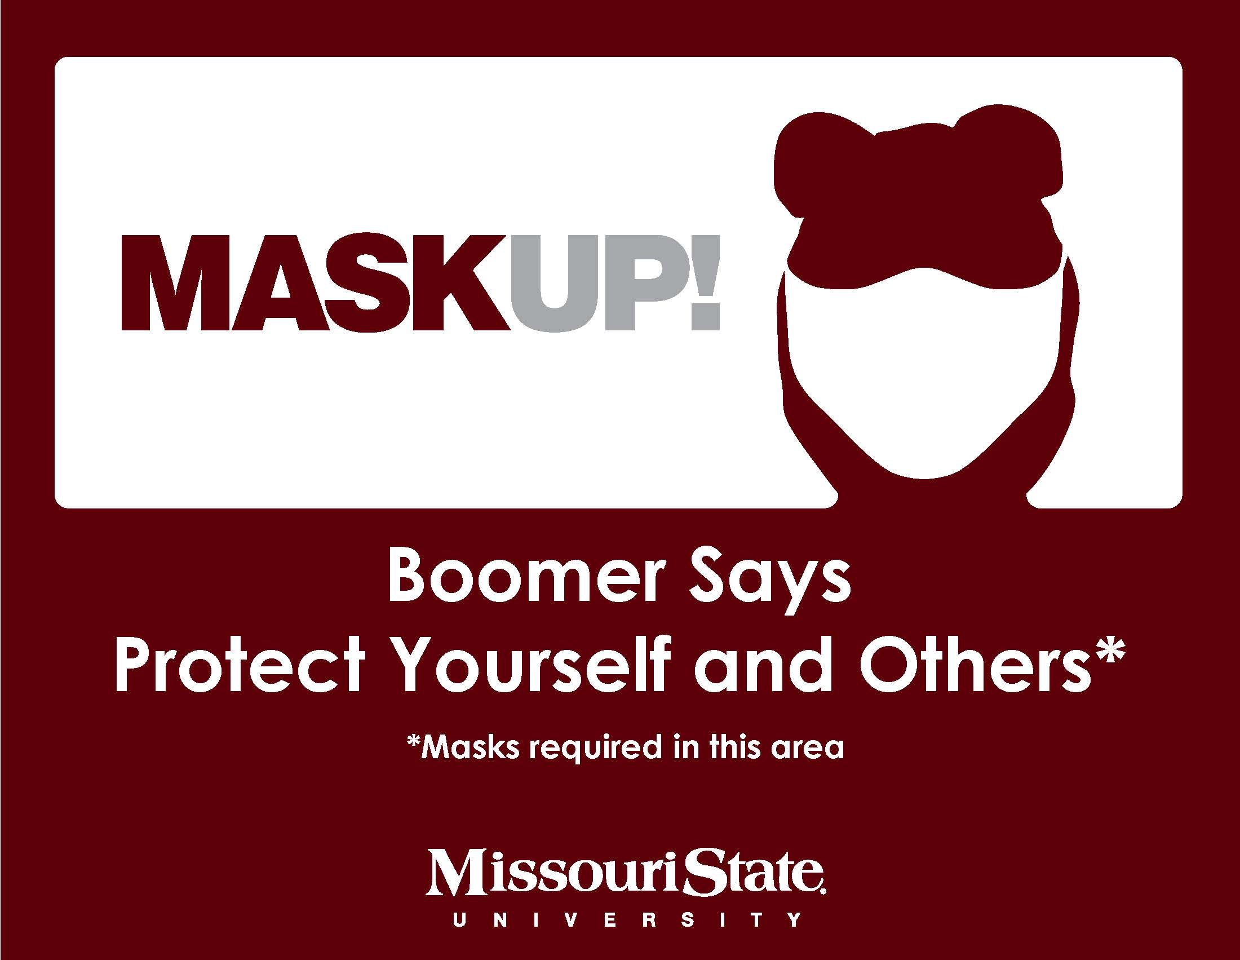
Mask Policy
Masking is required in all buildings on campus
  Masks are required to be worn in all buildings on campus, including in hallways, elevators, stairwells, classrooms, restrooms, study areas, departmental suites, and other common areas.
Exception when lecturing
  Faculty members are permitted to wear face shields while in the classroom, provided that the faculty member is able to maintain at least six (6) feet of distance from all students. Such face shields will be provided to faculty members by their colleges at no cost.
Additional Exceptions to indoor masking requirements
  Employees are not required to wear masks in their own private offices
  While eating in a dining hall or food court (e.g., Plaster Student Union, Union Club, Meyer Library, and Einstein Bros Bagels in Glass Hall)
  Masks must still be worn while entering or exiting a dining hall or food court and while waiting to obtain food in such locations

Slide 53
Masks vs. Face Shields in the Classroom
When faculty can maintain at least 6’ of physical distance from students, they have the option of wearing a face shield in lieu of a mask
A mask must be worn when traveling to/from class
Faculty may elect to wear both a mask and face shield

Slide 54
COB Compliance Plan
  Proactive Strategies
    University & College Communication
    Exterior and Interior MASKUP! Signage
    Masking Policy included in standard University Syllabi Policy Statements
      Bb link to these policy statements
  In-Class Communication
    Standard Start of Class Statement
    Standard Steps To Address Noncompliance
    Department Heads and Deans on Call

Slide 55
Courtesy Masks
Each computer cart has a supply of courtesy masks for students and guests.
Please help us by locking the keyboard drawer and cart after each class
Let COB Computing know if the mask supply is exhausted

Slide 56
FAQ I
How will I know if a student has COVID-19?
  Students will be instructed to inform you if they will be out of class
How will I know if other students or I have to be tested or Quarantined?
  MSU COVID-19 Response Team will contact you
Can I move my class online if a student tests positive?
  No, changes in modality will be determined in consultation with the department head and dean.
  If multiple students are in isolation (test +) or quarantine please consult with your department head

Slide 57
FAQ II
What should I tell other students if a classmate tests + or is absent for several class periods?
  Under HIPPA you should not discuss students’ health issues with others. You can remind students that the Response Team will contact them if they’ve had “close exposure”
What should I do if I have concerns about an ADA accommodation.
  Contact Disability Resource Center and/or your DH

Slide 58
FAQ III
Where do we get MSU provided N95 masks?
  When COB receives an allotment of masks they will be distributed to department offices on pro rata basis.
  To date we have received two allotments, both of which have been distributed.
  The Provost knows how many N95 masks are needed by each Academic unit and disperses them as they become available from Emergency Management.

Slide 59
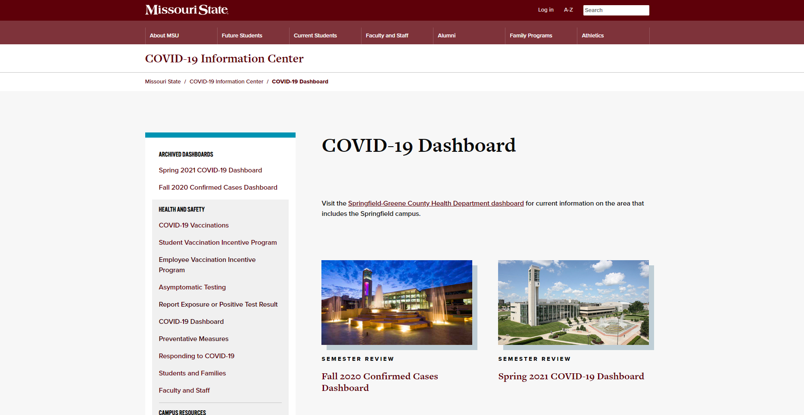
COVID-19 Dashboard
COVID-19 Information Center

Slide 60
Department Shoutouts
SOA
FGB
ITC
MFD
MGT
MKT
TCM
GRAD PROGRAMS
BAC

Slide 61



TITLE
Have a
Great Year, and…
Content

