Slide 1
Spring 2017 All-COB Meeting “Quality in All We Do” May 12, 2017

Slide 2
Agenda
COB Update
Glass Hall Update
AACSB
Shout-outs
Awards

Slide 3
COB Update

Slide 4
2017-18 Budget Overview
Not as bad as we initially feared – potentially additional money (if Governor doesn’t withhold) added back – will know more in fall.
COB took a conservative approach
Our cut was $92,962 (original budget scenarios were as much as $967,000 cut from COB budget)
One line cut, overage added to salary savings
One line frozen
Internet incentive money goes from $55 to $40/head eff. Fall
Thank you to COB Budget Committee
We will carefully watch next year’s budget outlook

Slide 5
Enrollment
Always an important part of MSU budgeting picture
We are watching closely
Admissions are up but registrations are slightly down

Slide 6
Hiring
We hired two people for this fall
Dr. Josh Coleman
New Graduate coming from University of Memphis, replacing Amy Stokes
Dr. Puneet Prakash, Baker Chair
Coming from Virginia Commonwealth University
Hiring for Fall 2018-19
Expect somewhere around 8 positions
Searches to start this summer for conference cycle

Slide 7
Retirements
Faculty & Staff Retirements
Michal Dale
Phil Harsha
Mike Hignite
Corinne Karuppan
Peggy Piekarski
Jim Scott

Slide 8
Glass Hall Update

Slide 9
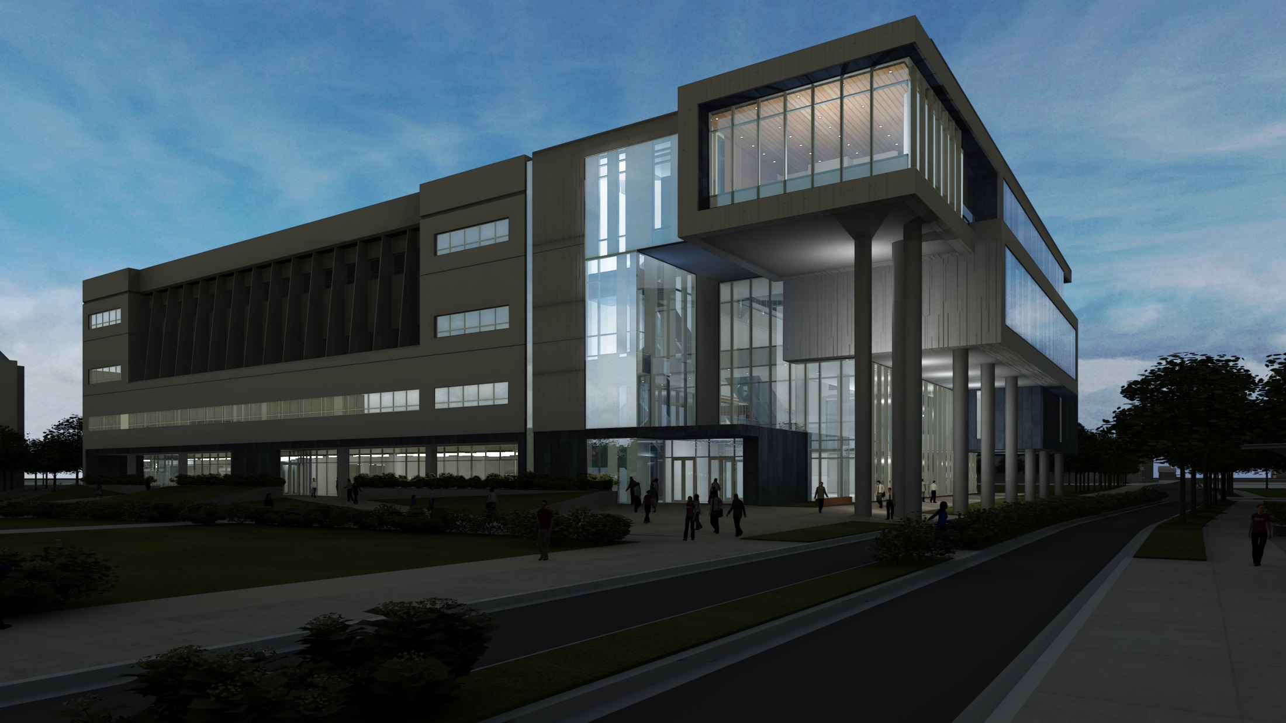
New dramatic front door for facility
Renovation and Addition to Glass Hall

Slide 10
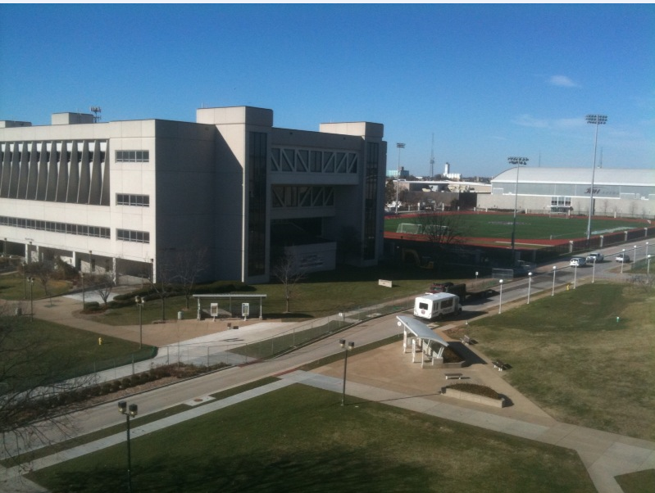
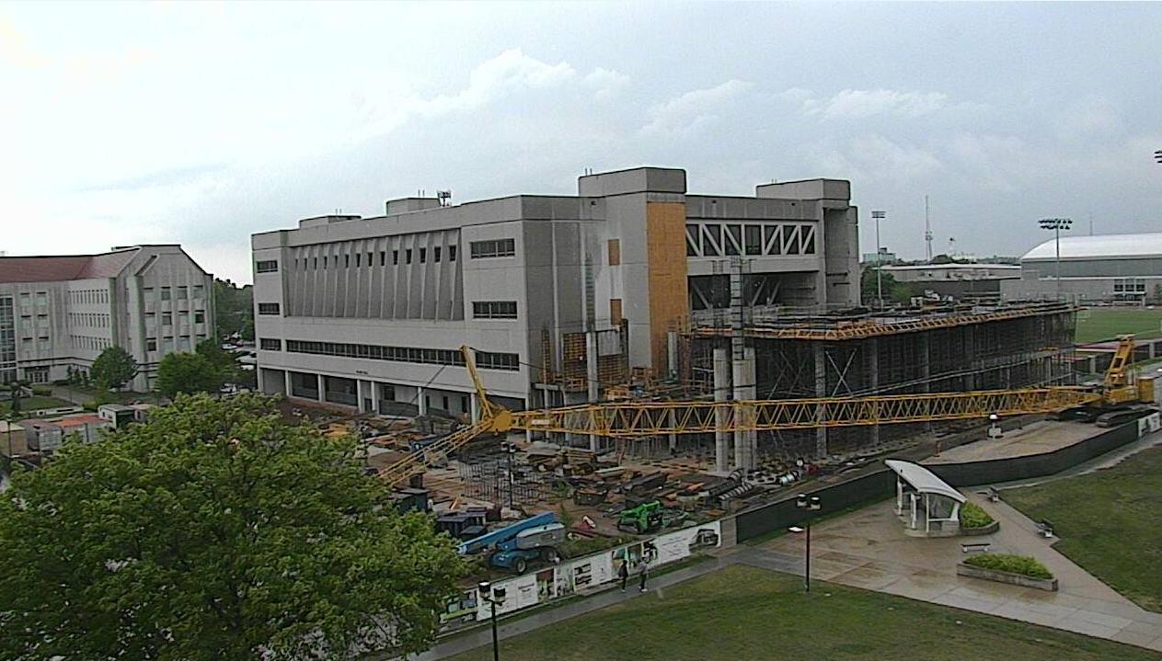
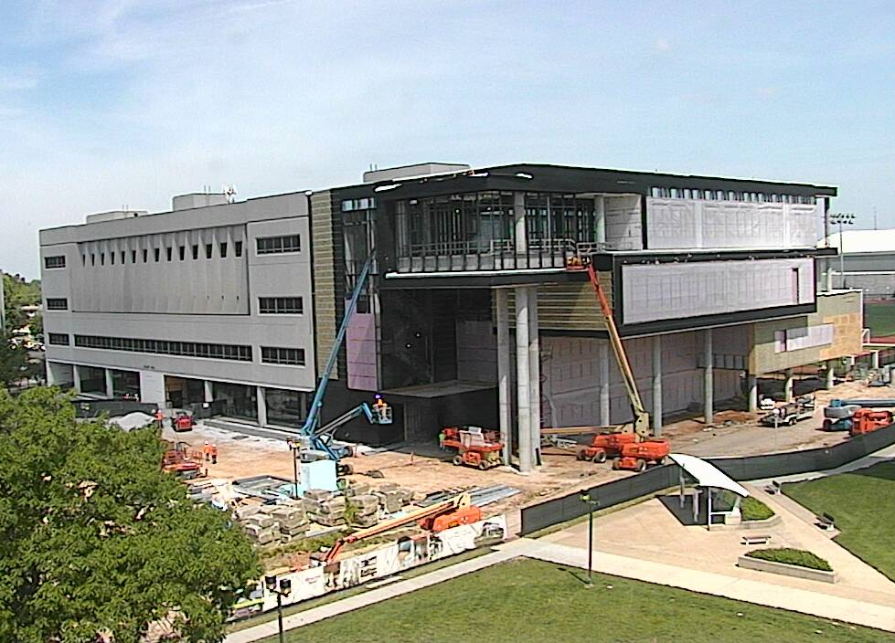
Progress….
Nov 2015
May 2016
May 2017

Slide 11
Renovation & Construction To Date
Glass Hall
90% of original building renovation complete
2nd floor offices (15) complete
80% of the 1st floor west renovation complete (Trading Lab, Grad Programs Office, Entrepreneurship Lab, relocated restrooms, etc.)
Addition
90% of mechanical, electrical, & plumbing systems complete
BAC & Career Center offices drywall installed
Auditorium & E-classroom tiers installed
Skylights & Smoke Evacuation fans installed
90+ % of framing for glass curtain walls installed

Slide 12
Summer 2017 (Renovation)
SW and NW entrances & stairwells
Center entrances (N. & S. )
Finish space for Einstein Bros. Bagels
Add four teams rooms - SE(1), SW(1), & NW(2)
1st floor auditoriums (101, 102 & 108)
Departmental Offices Replace cabinets & countertops
Repair/Repaint Secondary Hallways
Dean’s Office
Finish fire lane on north side of Glass Hall
Remove Lot #19 & landscape around entire building

Slide 13
Summer 2017 (Addition)
Install glass curtain walls & entrances
Complete interior finishes
Construct interview rooms (2nd floor)
Construct 3 team rooms (3rd floor)
Install new windows in GLA436 (study lounge)
Install terrazzo flooring on 1st floor

Slide 14
Preparing for SU17
All Faculty
Mail & Packages, Strong 274
Voicemail
Unified Messaging for ALL COB (voicemail via email)
Off-campus retrieval 836-5888 , Enter #
COB Computing – COBcomputing@missouristate.edu or 836-6279
Summer School Faculty
Office Assignments Finalized and Distributed Via Email
Onsite Support -- Janet Davis, Strong 274
Photocopier & Scantron, Strong 253

Slide 15
Checklist for Closing Offices
Remove or store all valuables
Lock all drawers and filing cabinets - If you would like a seal placed on your larger cabinet,
please contact COB Computing
Computer
Backup to encrypted external hard drive and/or OneDrive for Business
Shutdown
Optional – take computer home for the summer
HVAC Consoles – turn off
Unplug all electrical appliances
Empty/defrost mini-refrigerators

Slide 16
Safeguarding Offices & Computers
Faculty Offices are not in the SU17 Project Scope
All COB computers should be encrypted
Contractor securing sub-master keys daily
Contractor assuming responsibility for documented loss or damage
Storage classrooms being rekeyed

Slide 17
Emergency Access to Offices
Highly limited
Pathway must be deemed safe by DeWitt
Must by escorted (COB Computing staff or Dr. Meinert)
By appointment (typically during contractor lunch hour)
Requires hardhat & safety glasses (COB provided)
No lengthy stays
AC, electric, and/or network may be off-line
Construction debris & dust likely

Slide 18
Finding COB Offices
SU17 Directory (offices change, phone # remain the same)
PCOB, STRONG, & KEMPER Floor Plans
Available via email & COB Web Page next week
Visiting PCOB
Parking

Slide 19
Preparation for Summer 2017
Relocating to Park Central Office Building
May 23, 2017
Thank you very much to those faculty allowing us to use their offices in PCOB
Access to Glass Hall during summer
Contact COB Computing or Dave Meinert

Slide 20
Timetable
Expected timing for remainder of project
Move back to Glass Hall – August 14, 2017 (substantial completion)
Ribbon cutting Thursday of Homecoming, October 26, 2017 (details in the fall)

Slide 21
AACSB Update
Accreditation Visit 2017-2018
February 11-13, 2018
Chairs:
Denise Smart, Texas State, Business Chair
Jim Greenspan, Accounting Chair
Major shout-out to Libby Rozell for outstanding work getting us ready for the visit!

Slide 22
Faculty Shout-Outs and Awards

Slide 23
Shout-Outs
School of Accountancy, Dick Williams
Computer Information Systems, Josh Davis
Finance and General Business, Kent Ragan
Management, Jeff Jones
Marketing, Ron Coulter
Merchandising and Fashion Design, Ron Coulter
Technology and Construction Management, Neal Callahan

Slide 24
Awards
Outstanding Research Paper (2 awards)
Committee Chair Steve Thomas
George Schmelzle
Lawrence Yang
Jenny Zhang - Presenter
Cathy Starr
Christina Simmers
Nebil Buyurgan

Slide 25
Award Winners
Dr. Barry Cobb (MKT)
Best Non-Empirically Based Research Paper
Dr. Ron Clark (MKT)
Best Empirically Based Research Paper
Presented by Jenny Zhang

Slide 26
Outstanding Service Award
Dr. Susan Crain (FGB)
Presented by Dean Bryant

Slide 27
Outstanding Professor
Dr. Kerri Tassin (SOA)
Presented by the COB Student Leadership Council
Presented by Erin Eckels

Slide 28
HAPPY SUMMER!

